Slide 1
Community oyster reef installation in Coney Island Creek, Brooklyn, NY. Oyster reefs can help protect coastal communities from damage done by extreme storms. Photograph by Hhetrick via Wikimedia Commons (CC BY-SA 4.0 license)

Slide 2
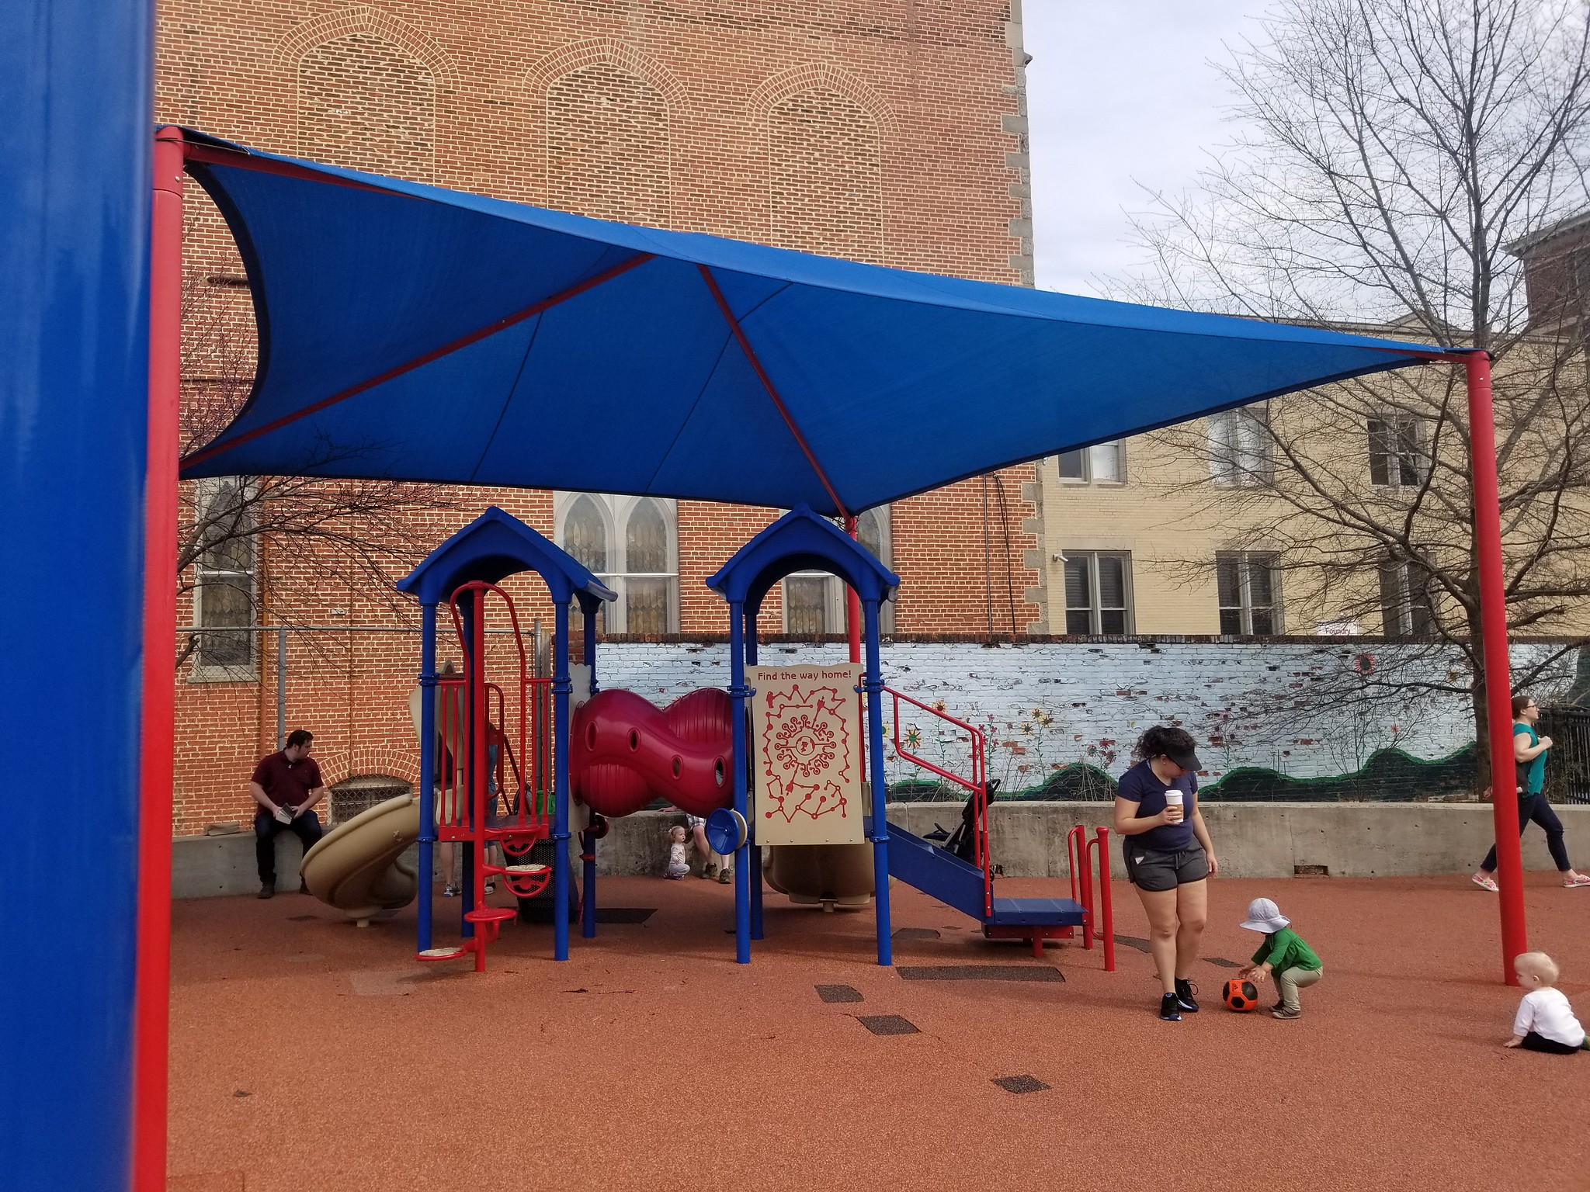
Shaded playground in Stead Park, Washington, DC by BeyondDC via Flickr (CC BY-NC 2.0)

Slide 3
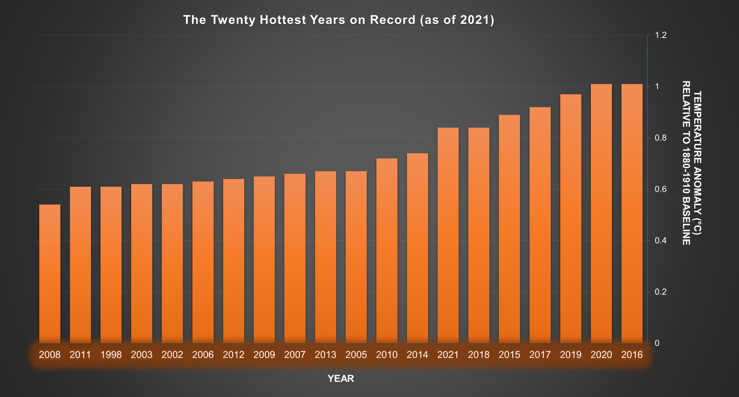
The twenty hottest years on record (global) as of 2021. All the record years but one (1998) are in the 21st century. Figure created by Ingrid Zabel for PRI's Earth@Home project (CC BY-NC-SA 4.0 license).

Slide 4
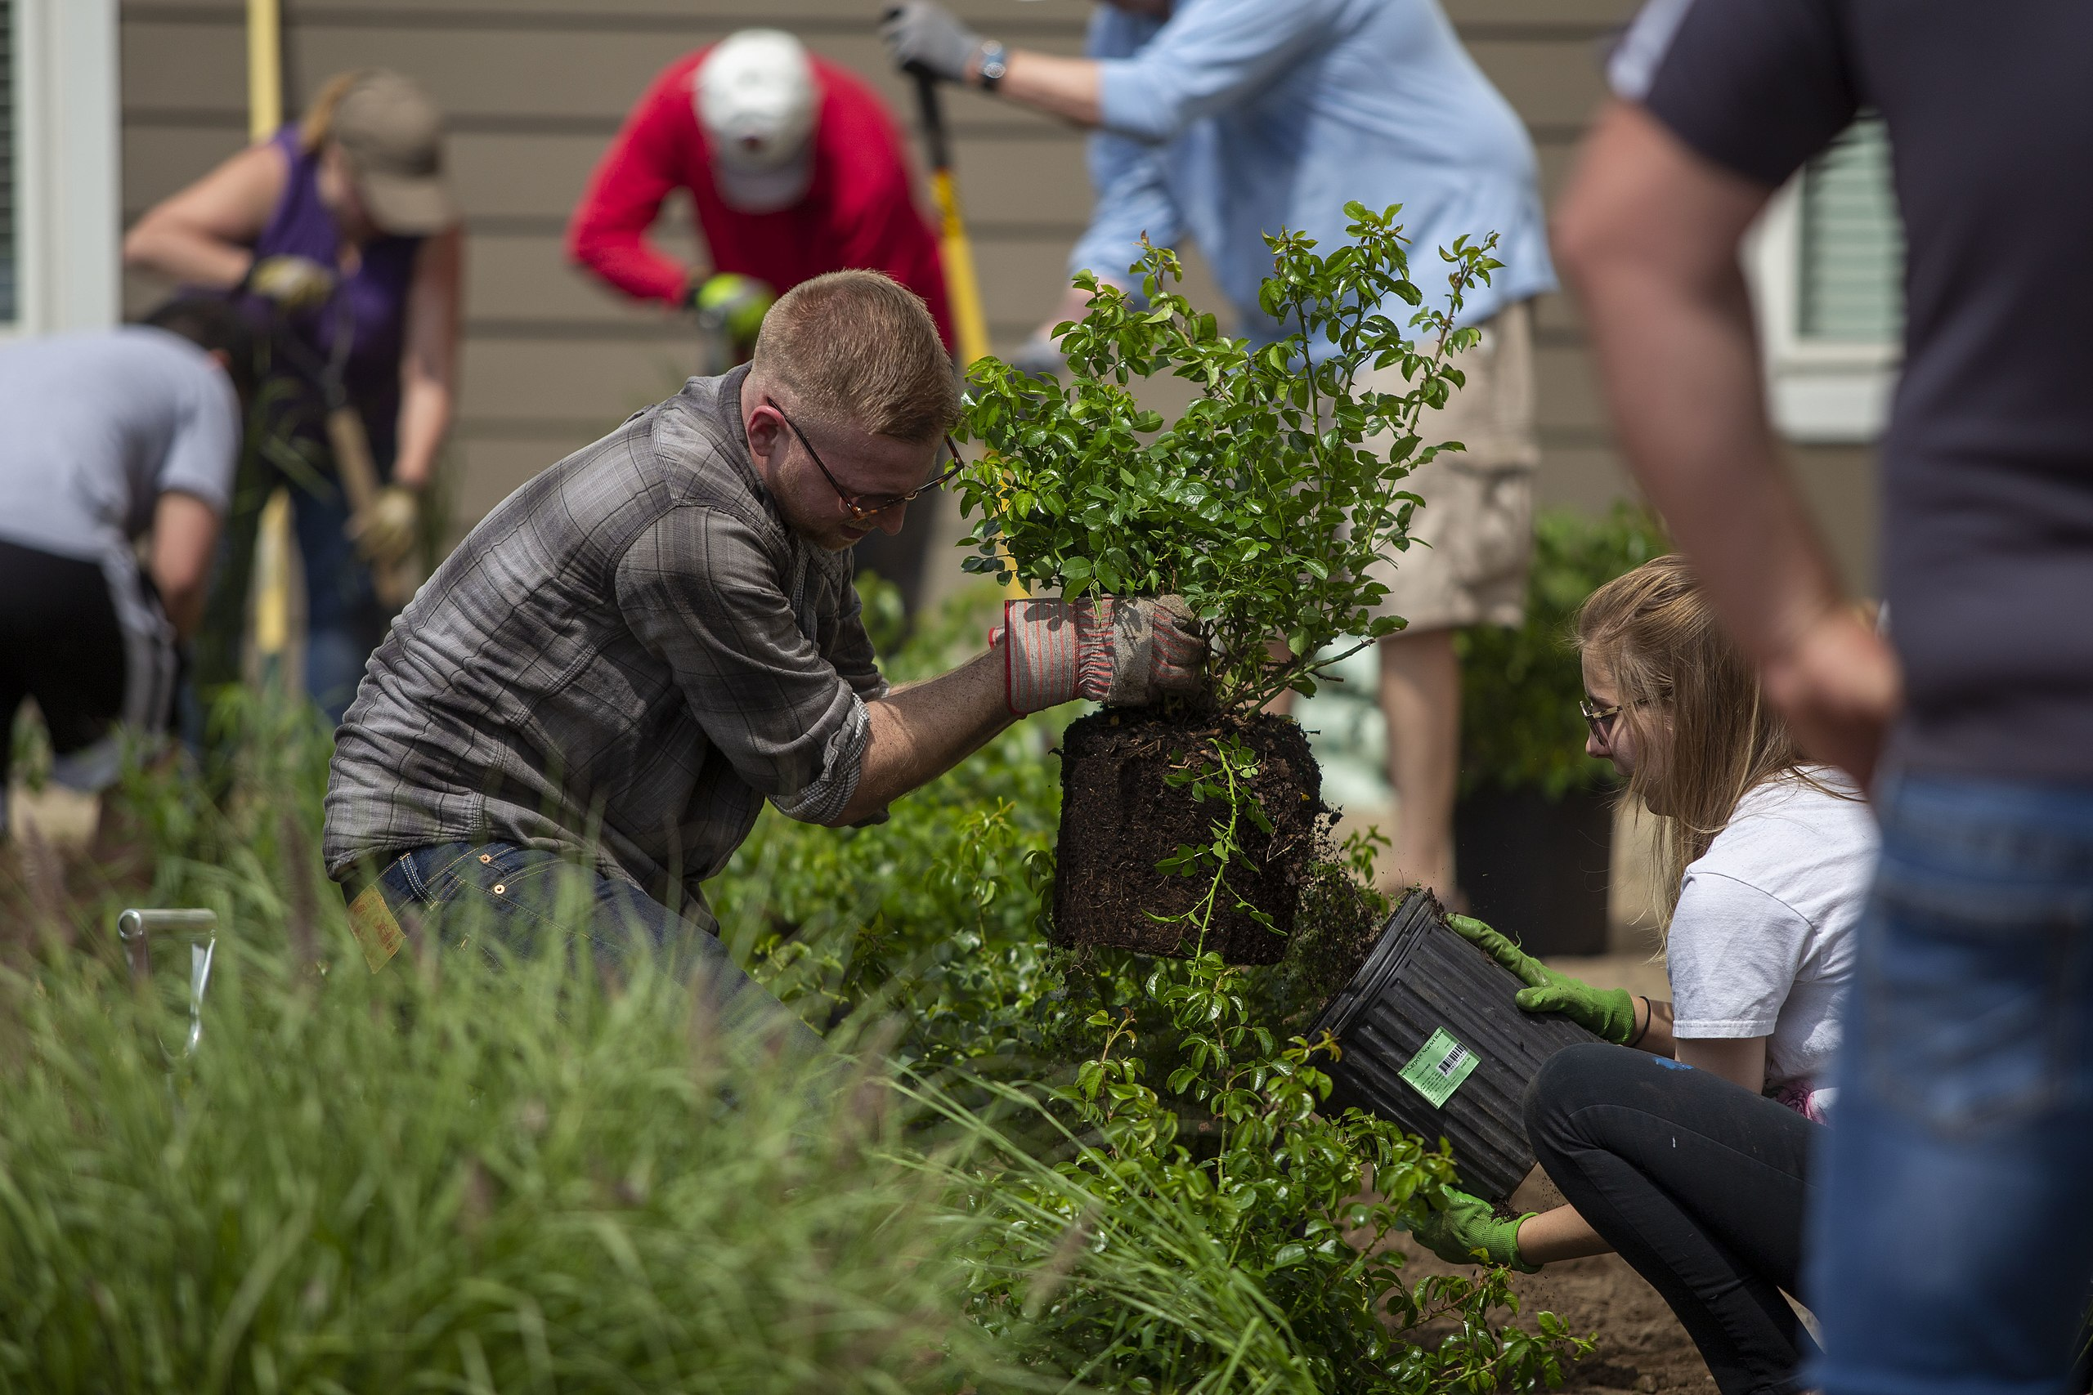
Community rain garden project in LaGrange, IL. Photo by College of DuPage Newsroom via Wikimedia Commons (CC BY 2.0)

Slide 5
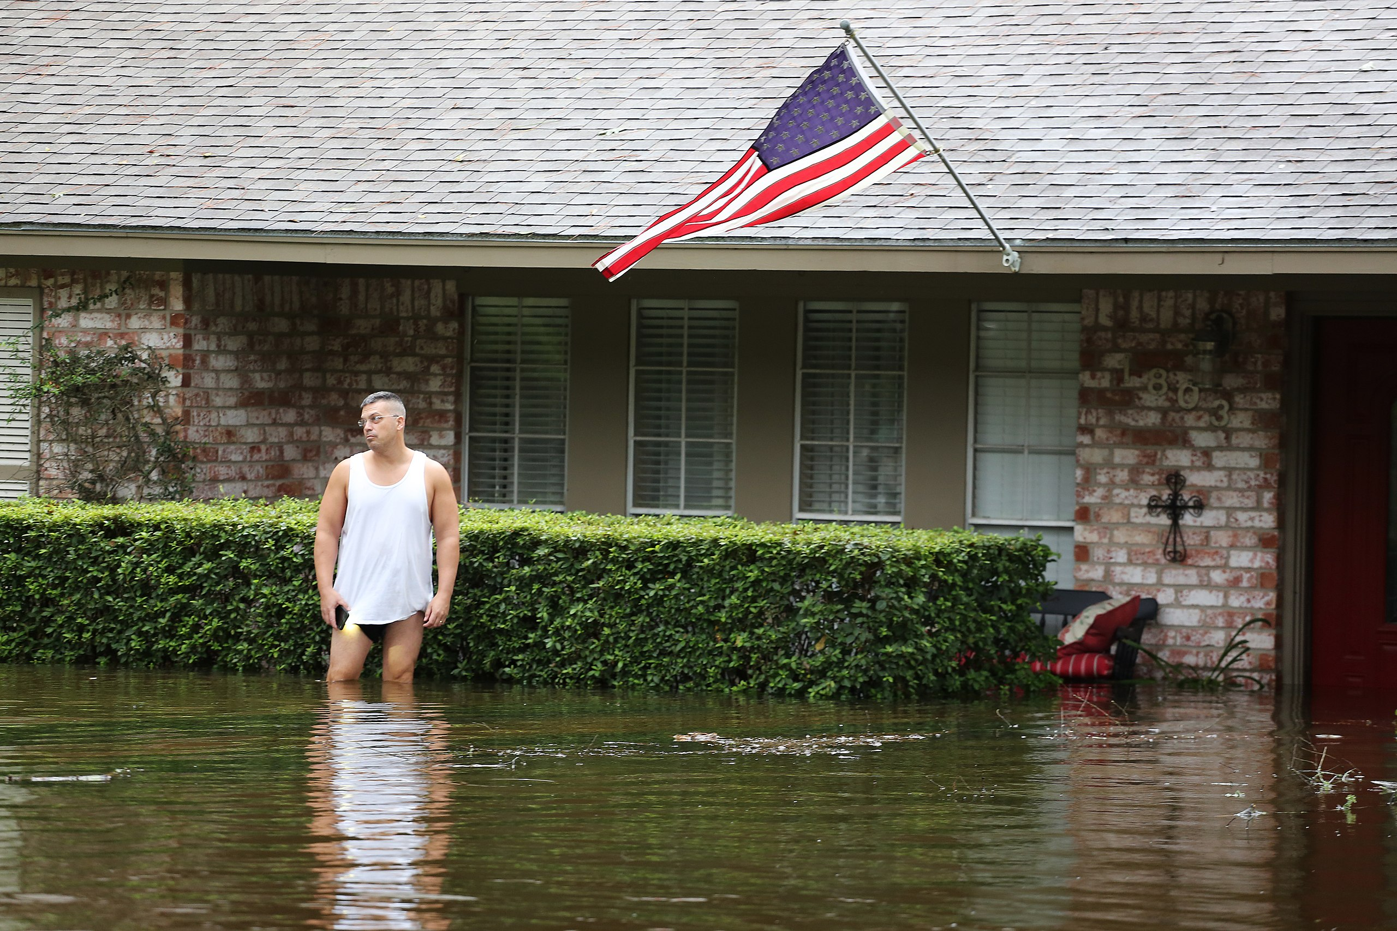
Flooding from Hurricane Harvey, 2017. Photo by Jill Carlson via Wikimedia Commons (CC BY 2.0).

Slide 6
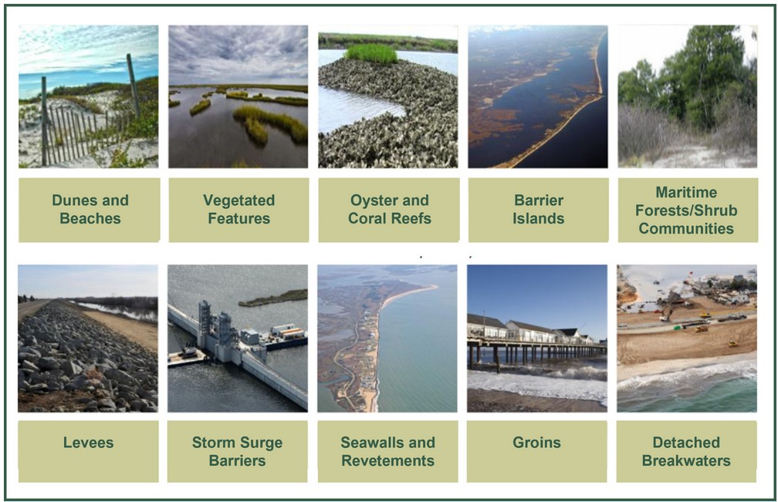
A variety of techniques for stabilizing and protecting coastal areas, both nature-based and structure-based. Image adapted from "Coastal Risk Reduction and Resilience: Using the Full Array of Measures" by the US Army Corps of Engineers (2013)

Slide 7
Rain garden in the Allen Centennial Gardens on the campus of the University of Wisconsin-Madison. Photo by James Steakley via Wikimedia Commons (CC BY-SA 4.0) . Image cropped by PRI.

Slide 8
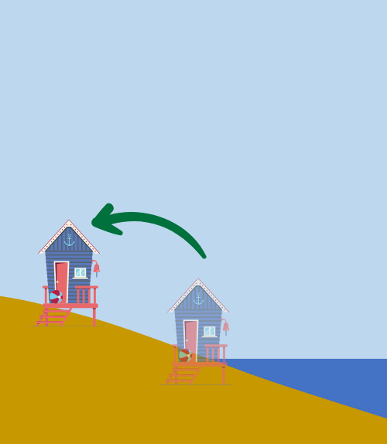
Beach house relocated to higher ground. Image created by Ingrid Zabel for PRI's Earth@Home project (CC BY-NC-SA 4.0 license) with images from Canva

Slide 9
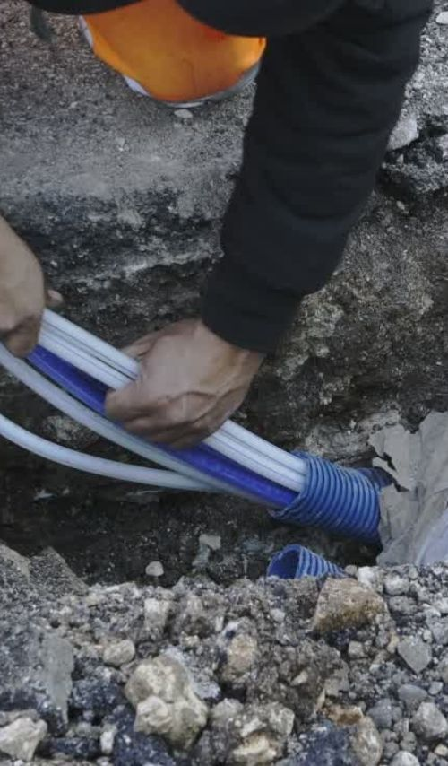
Worker installing underground fiber optic cables. Photo: Canva

Slide 10
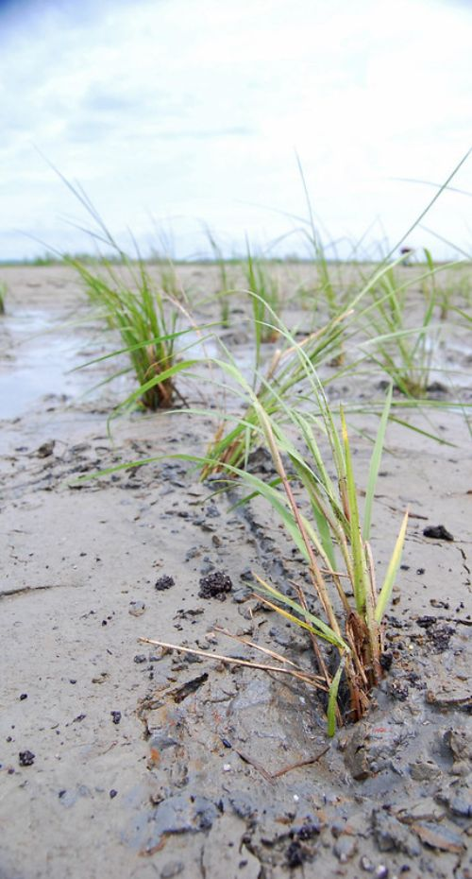
Newly planted marsh grass on a beach in Maryland. Photo: Alicia Pimental for Chesapeake Bay Program, CC-BY-NC 2.0 via Flickr. Image cropped by PRI.

Slide 11
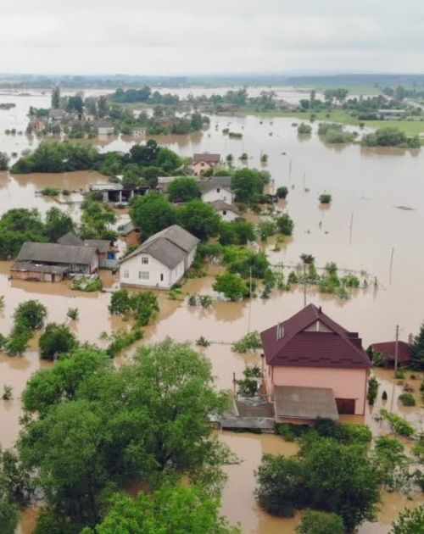
Flooded buildings and land. Photo: Canva

Slide 12
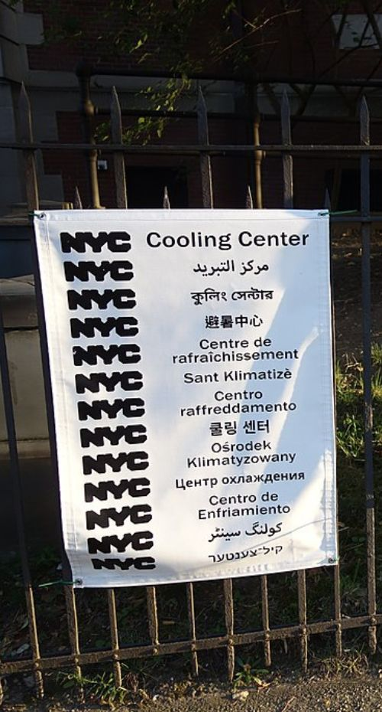
Cooling center sign at a library in Brooklyn, NY. Photo by Tdorant10 via Flickr, CC BY-SA 4.0 . Image cropped by PRI.

Slide 13
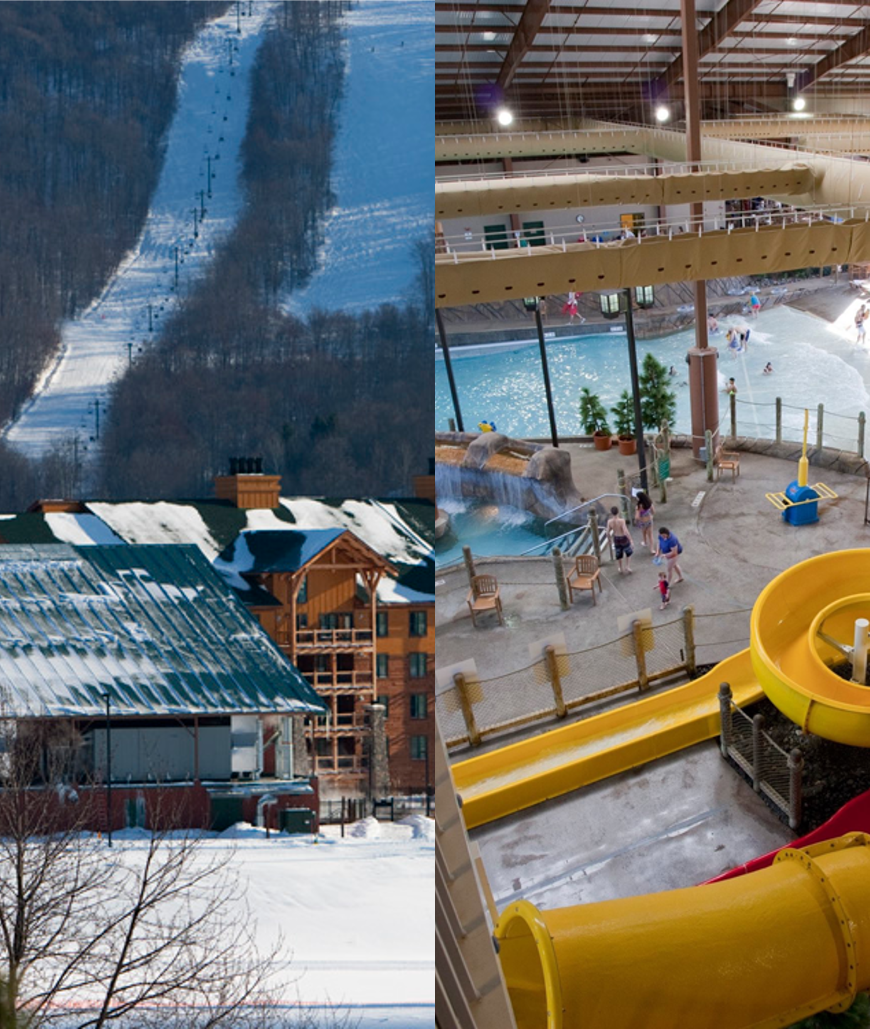
Ski slopes and indoor water park at Greek Peak Mountain Resort, Cortland, NY. Photos: Greek Peak Mountain Resort

Slide 14
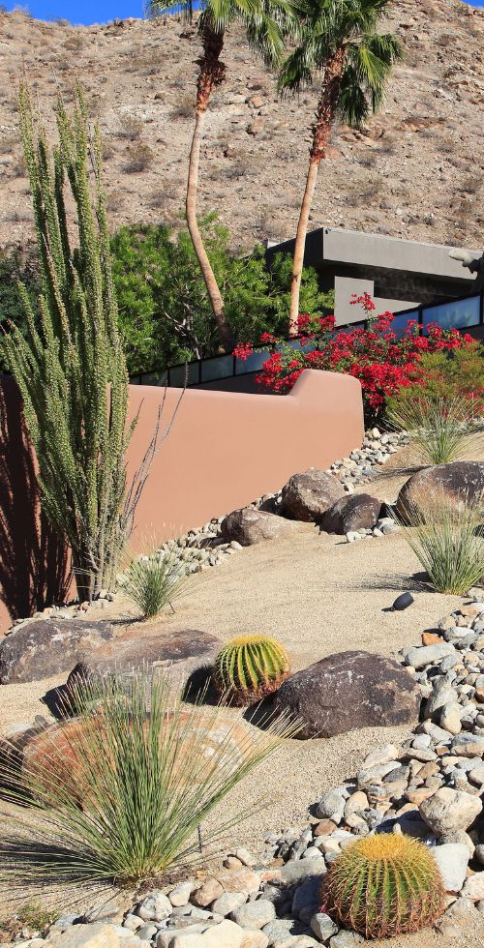
A garden for an arid environment. Photo: Canva

Slide 15
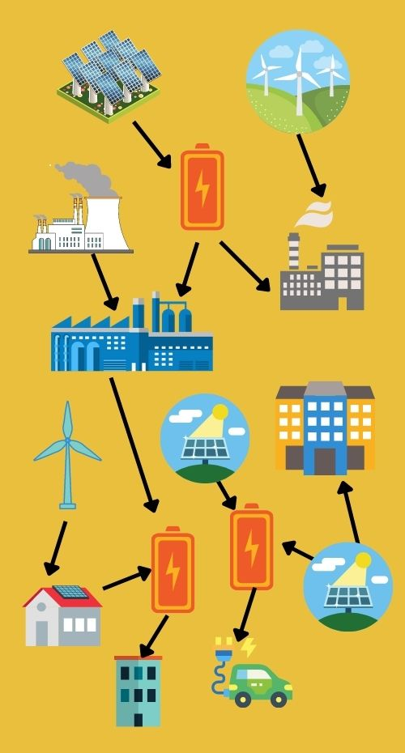
Diagram of distributed power generation. Image created by Ingrid Zabel for PRI's Earth@Home project (CC BY-NC-SA 4.0 license) with images from Canva

Slide 16
Image created by Ingrid Zabel for PRI's Earth@Home project (CC BY-NC-SA 4.0 license) with images from Canva

Slide 17
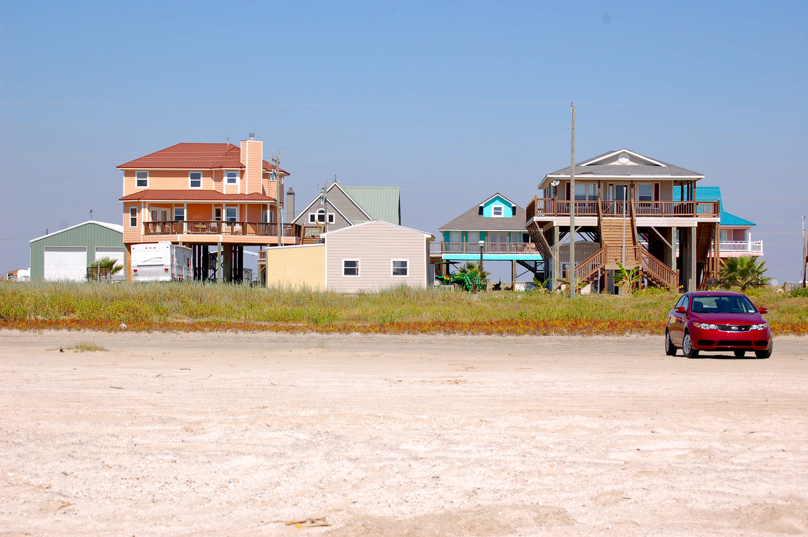
Community oyster reef installation in Coney Island Creek, Brooklyn, NY. Oyster reefs can help protect coastal communities from damage done by extreme storms. Photograph by Hhetrick via Wikimedia Commons (CC BY-SA 4.0 license)

Slide 18
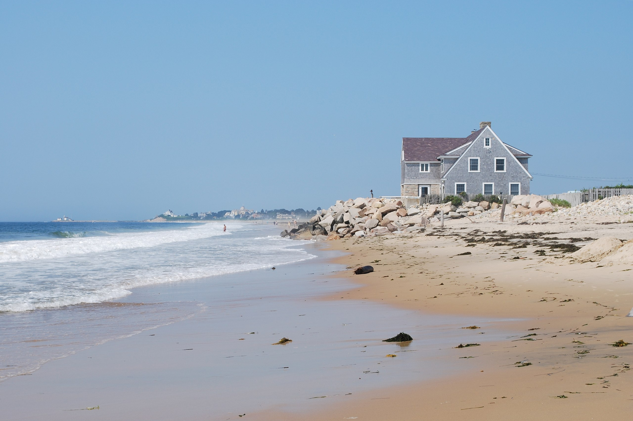
Beach house at Misquamicut Beach, RI. Photo by Juliancolton via Wikimedia Commons (public domain)

Slide 19
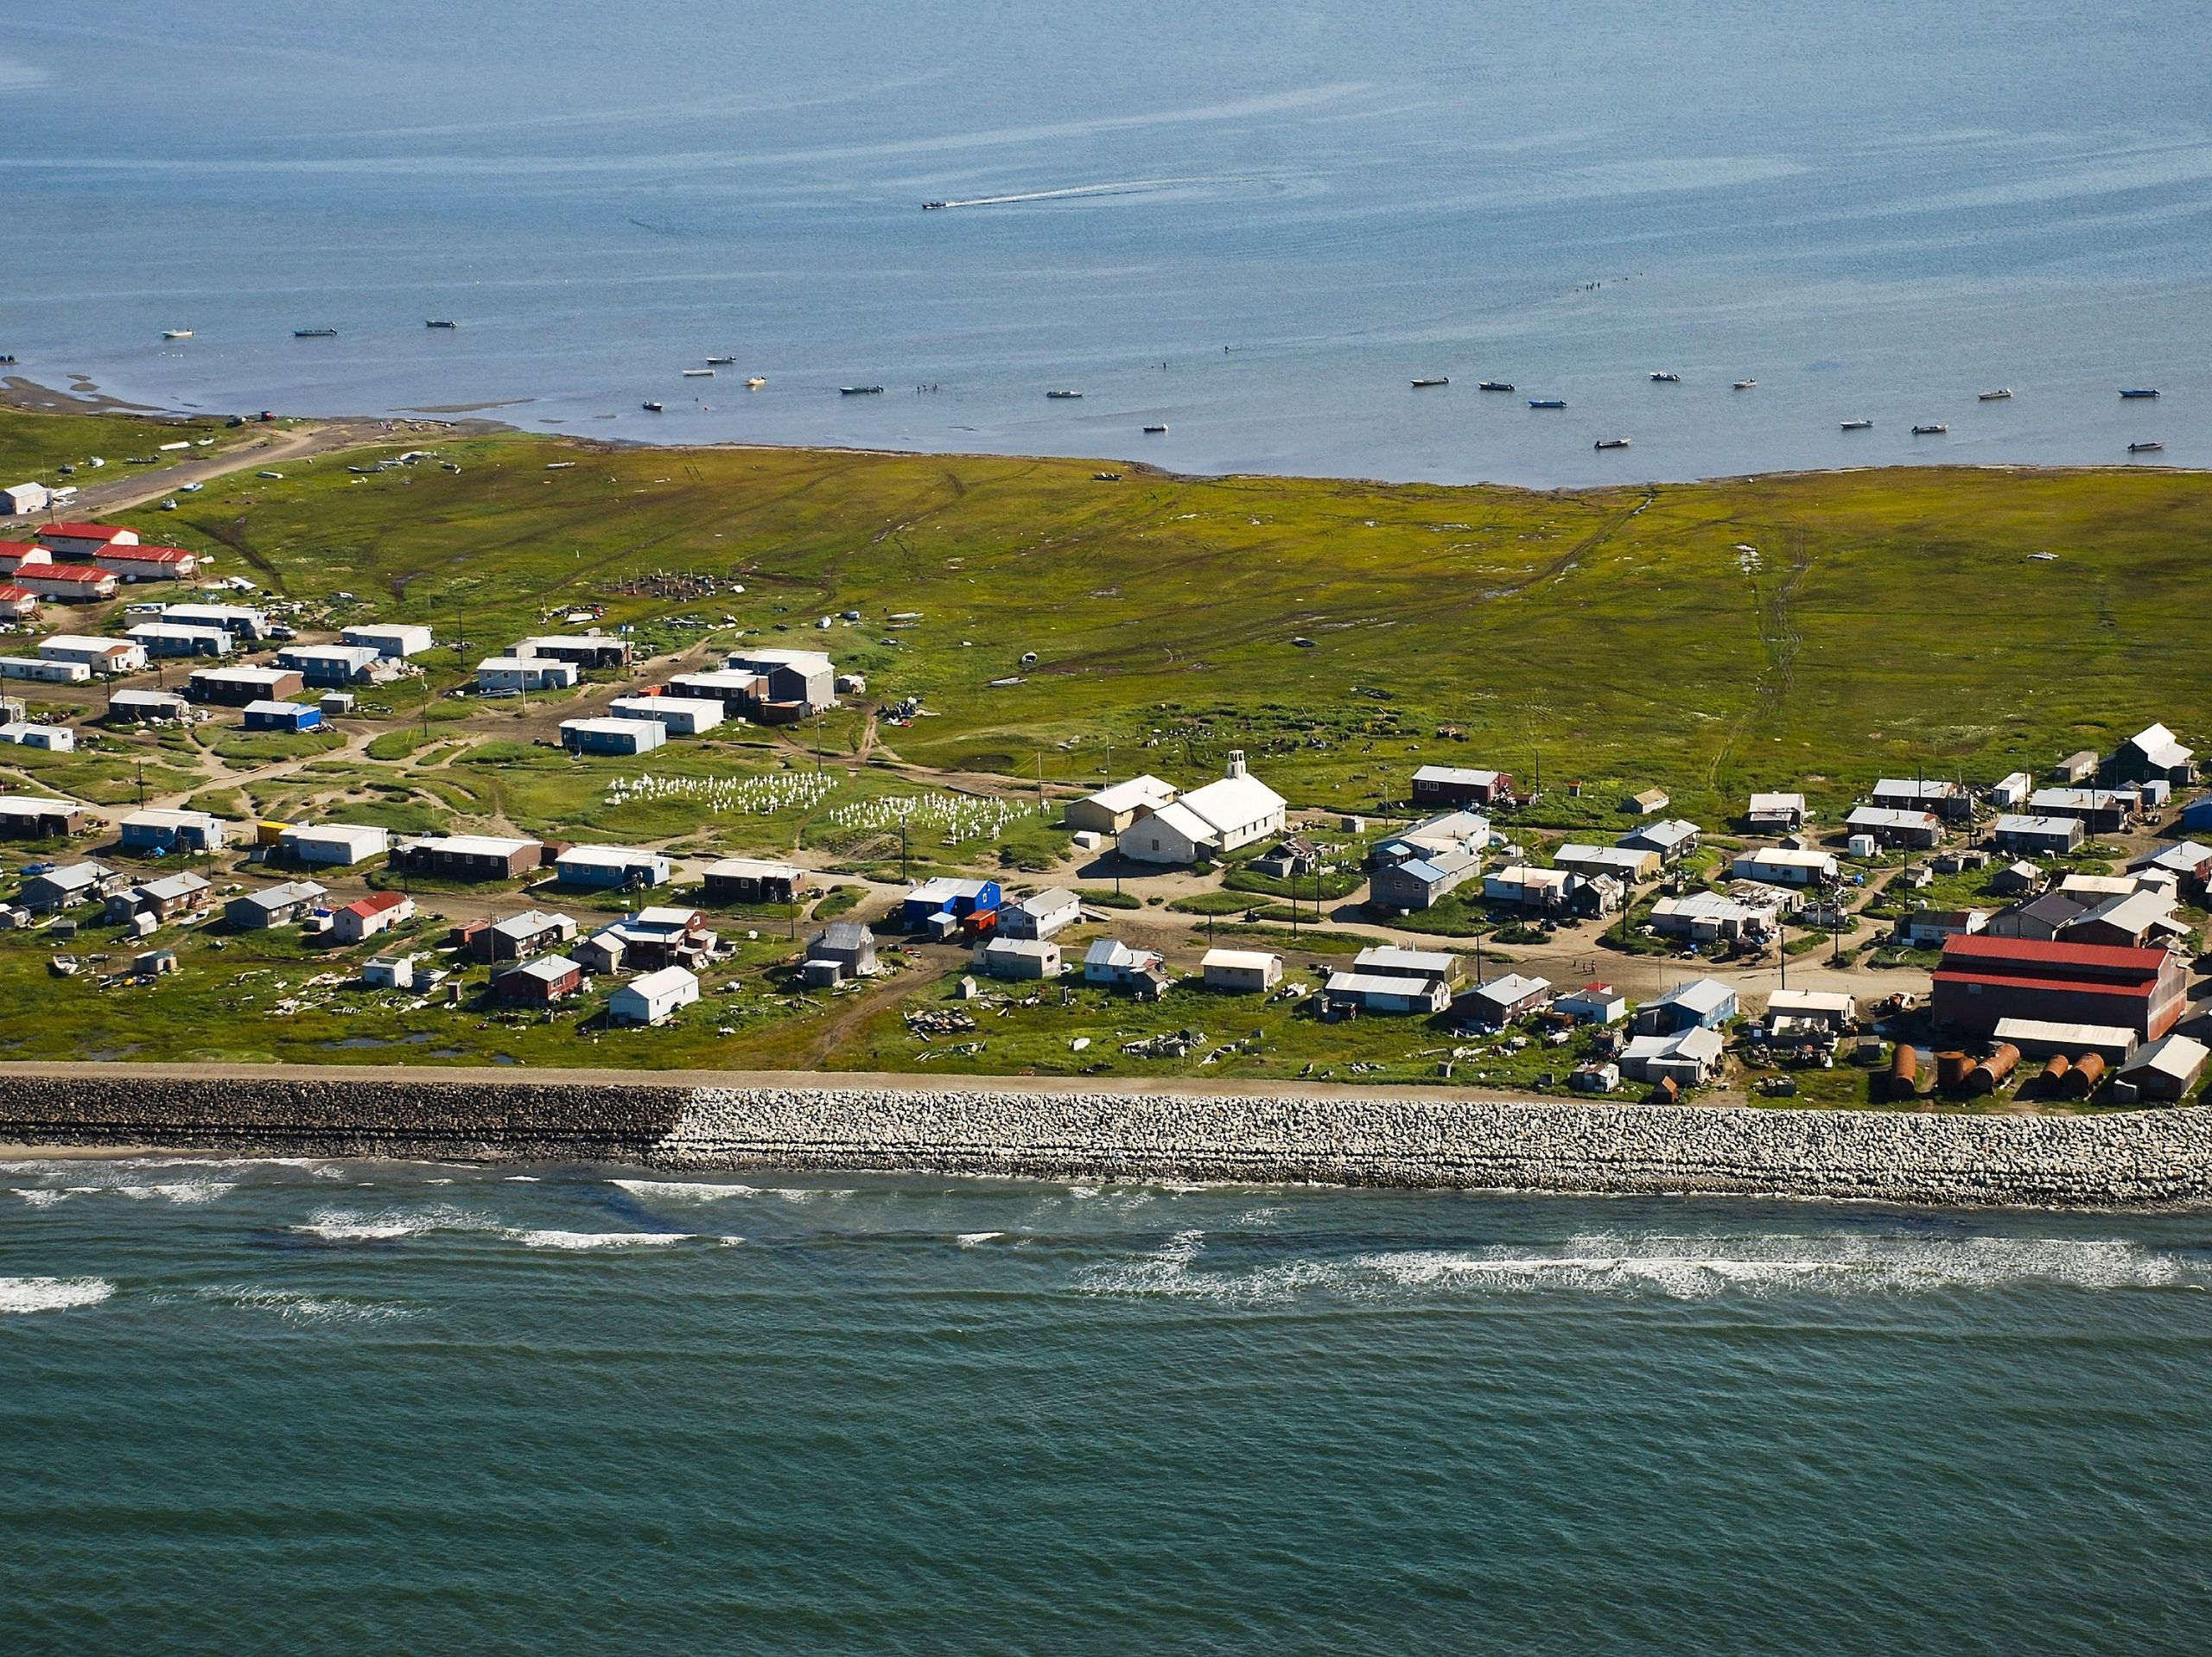
Village of Shishmaref, AK, which voted in 2016 to move inland. Photo: Bering Land Bridge National Preserve via Wikimedia Commons (CC BY 2.0)

Slide 20
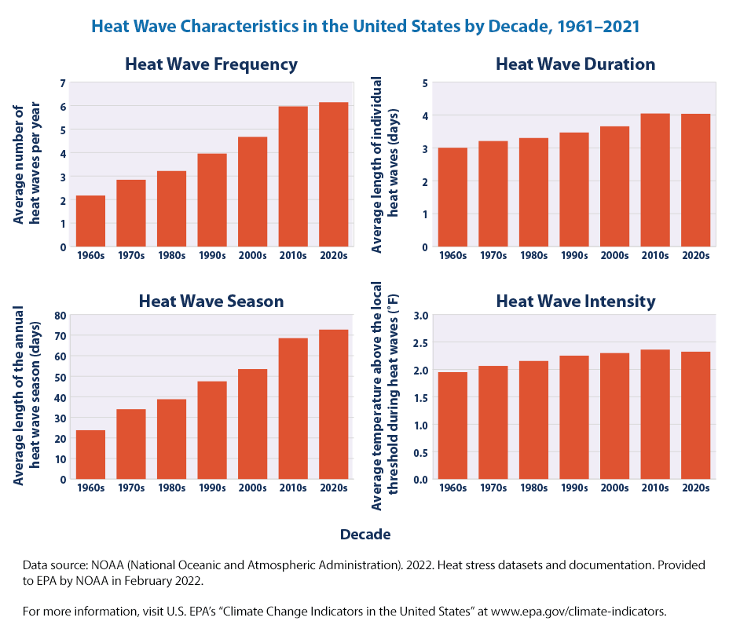
Data showing how heat waves in the U.S. have become more frequent, longer in duration, and intense since the 1960s, and how the heat wave season has expanded during this time period. Image from U.S. EPA Climate Change Indicators website.

Slide 21
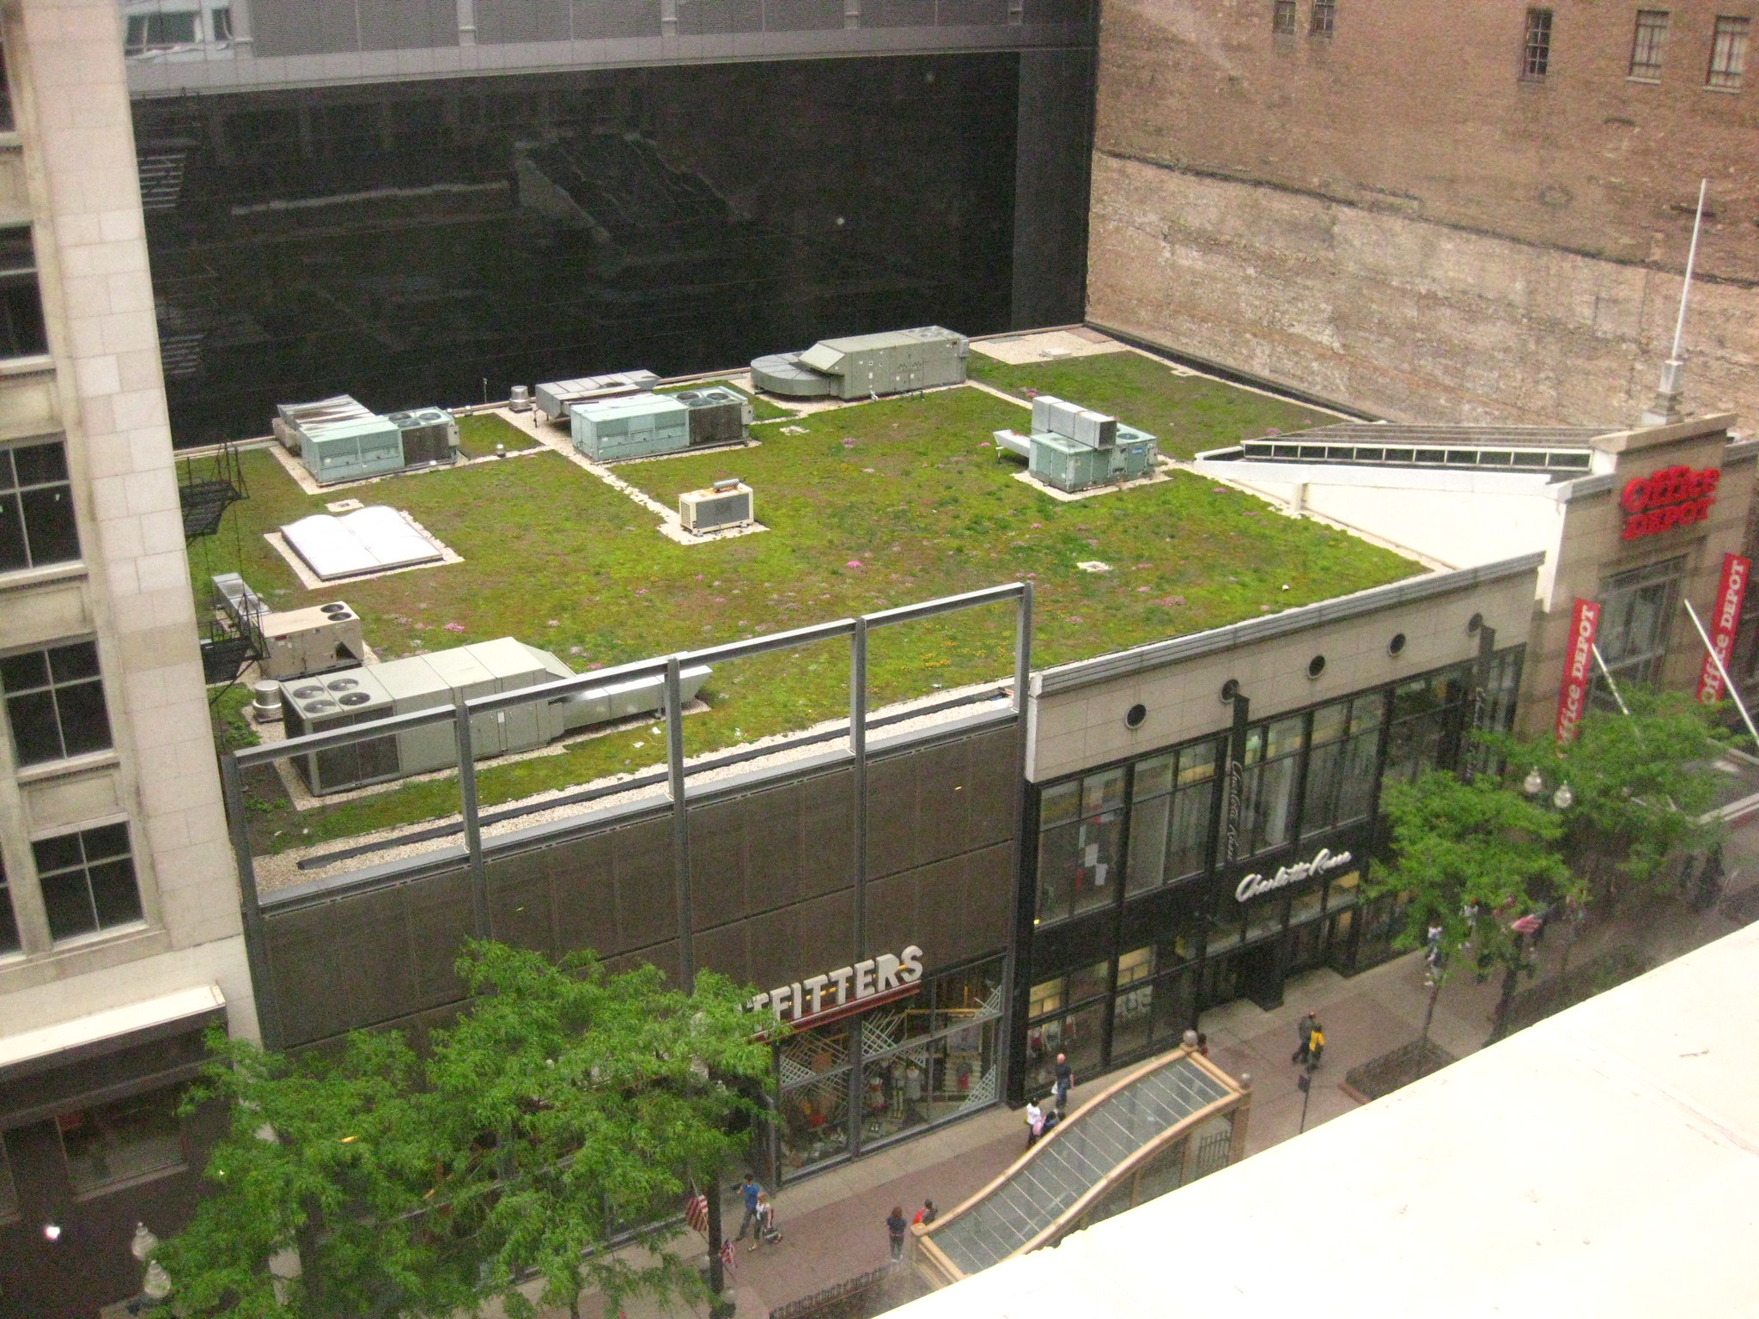
Green roof on a building in Chicago. Photo by Andrew via Flickr (CC BY 2.0)

Slide 22
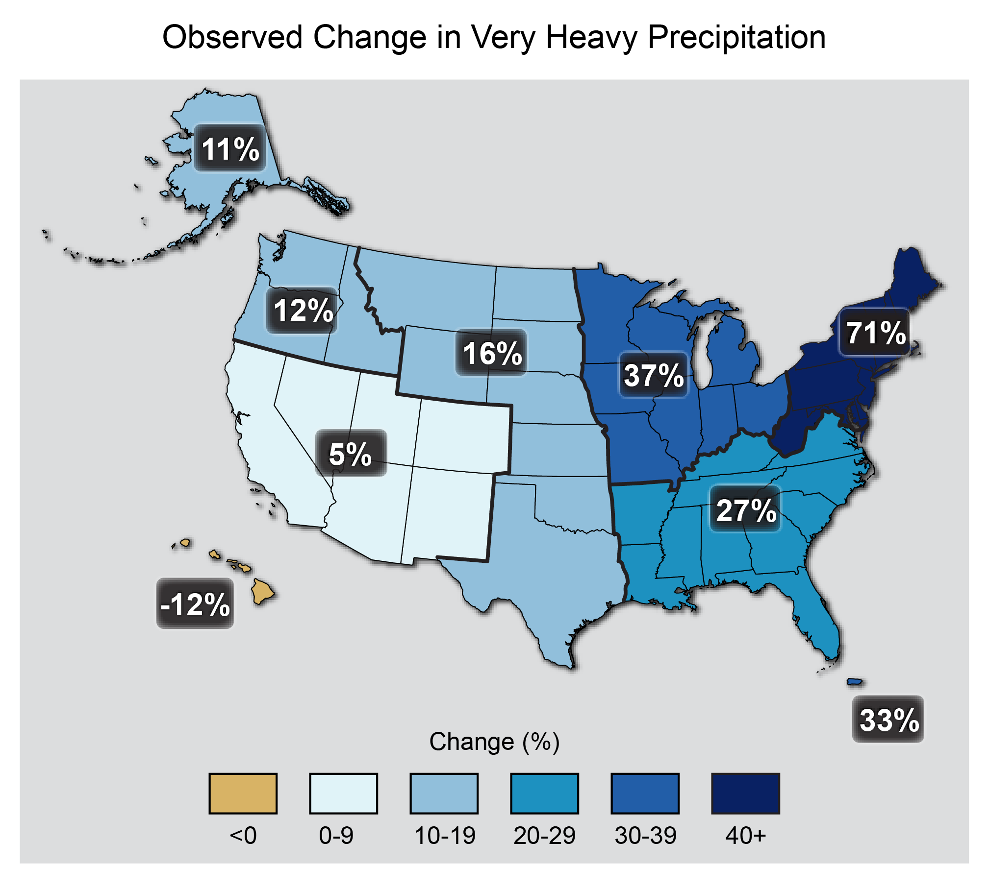
The map shows percent increases in the amount of precipitation falling in very heavy events (defined as the heaviest 1% of all daily events) from 1958 to 2012 for each region of the continental United States. These trends are larger than natural variations for the Northeast, Midwest, Puerto Rico, Southeast, Great Plains, and Alaska. The trends are not larger than natural variations for the Southwest, Hawai‘i, and the Northwest. The changes shown in this figure are calculated from the beginning and end points of the trends for 1958 to 2012.Map: US Third National Climate Assessment (2014). Original source: updated from Global Climate Change Impacts in the United States (2009); Thomas R. Karl, Jerry Melillo, and Thomas C. Peterson, eds., US Global Change Research Program.

Slide 23
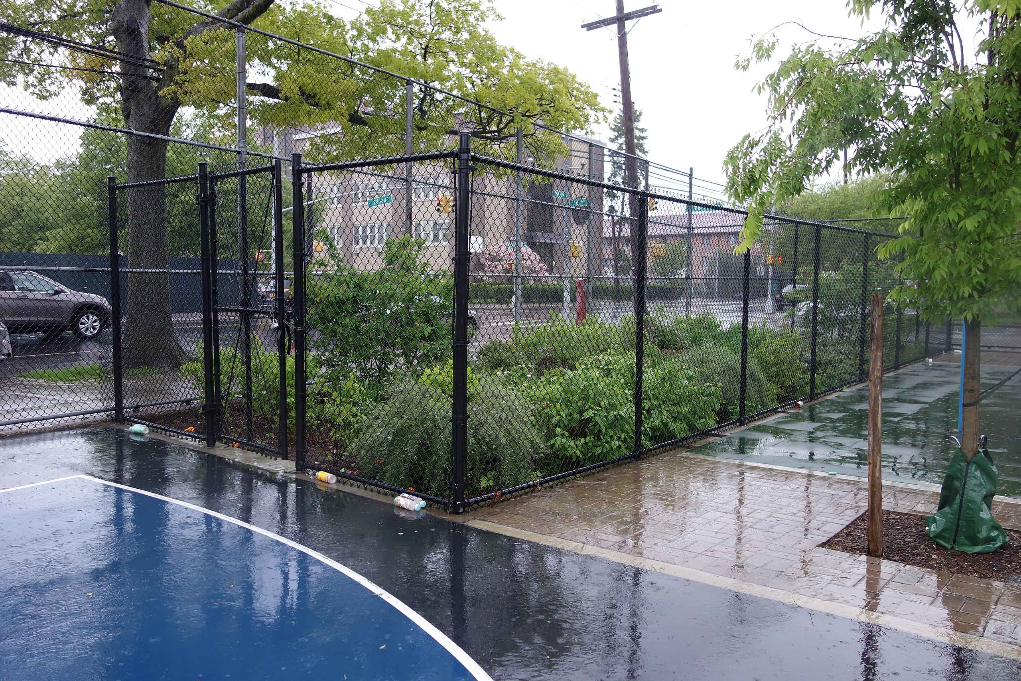
Rain garden near a public playground in Kew Gardens Hills, Queens, NY. Photo: Tdorante10 (CC BY-SA 4.0) via Wikimedia Commons

Slide 24
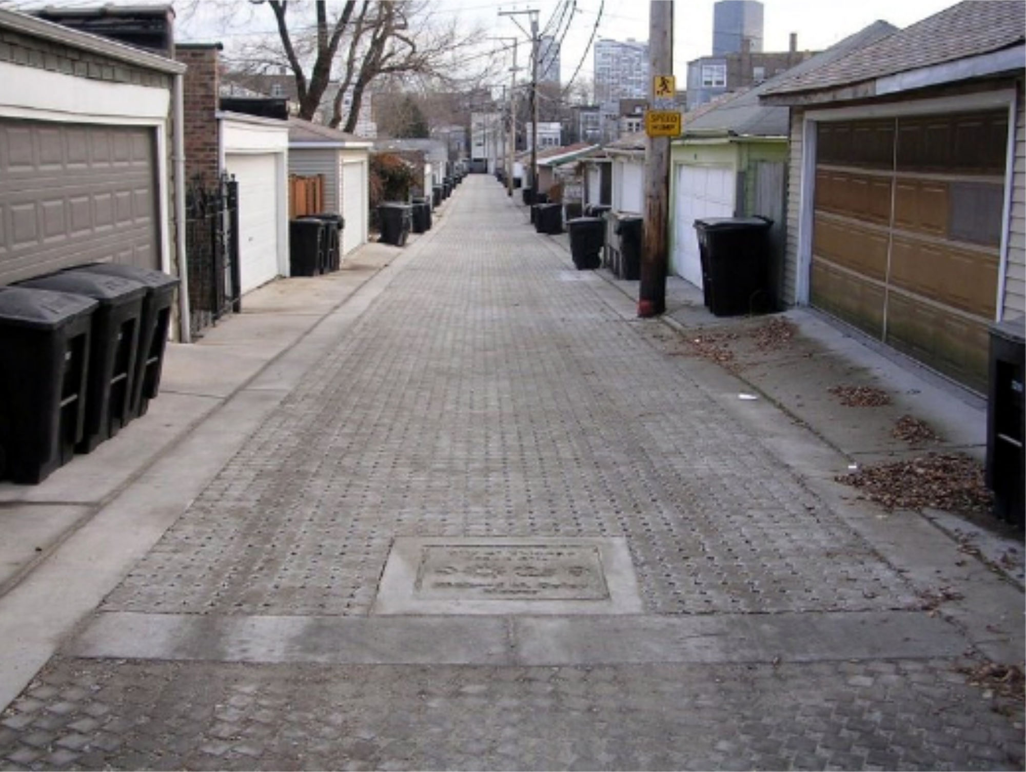
Permeable pavement in an alley in Chicago, IL. Photo: US EPA, public domain via Wikimedia Commons.

Slide 25
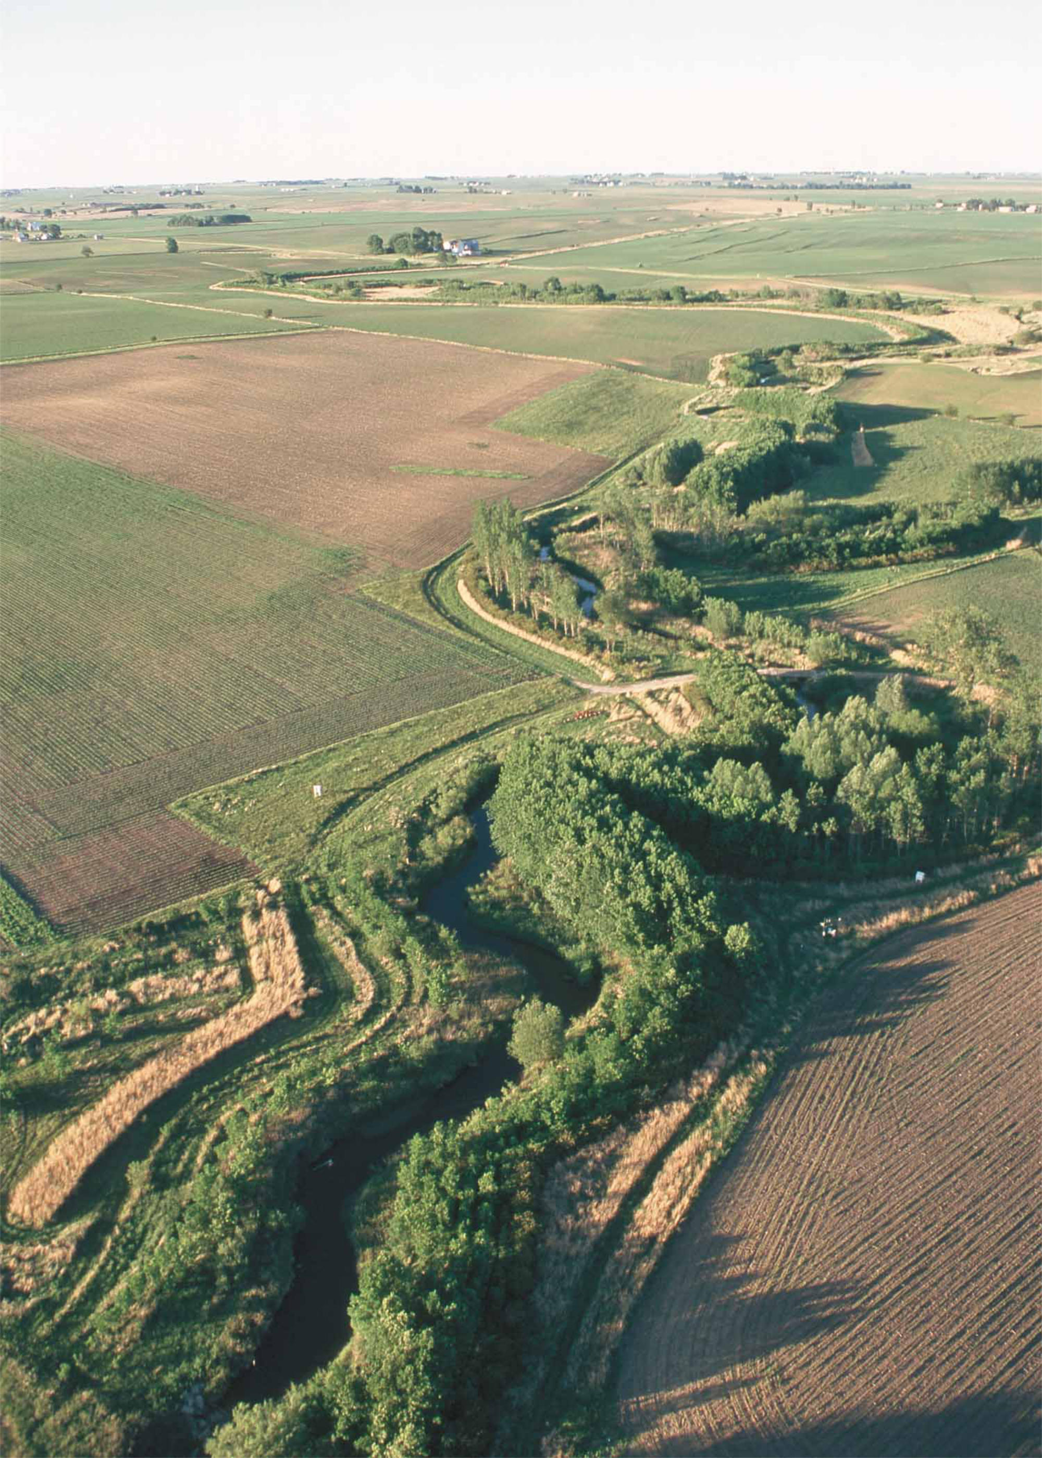
Riparian buffer on Bear Creek in Story County, Iowa, with farm fields on either side. Photo: USDA, public domain via Wikimedia Commons

Slide 26
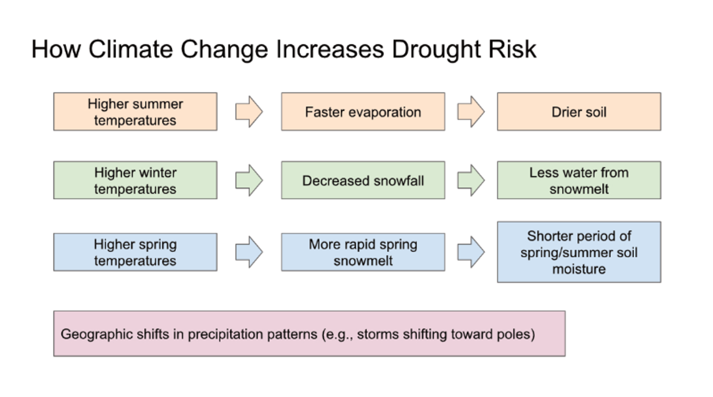
Diagram summarizing several different ways that increasing seasonal temperatures and changing precipitation patterns can increase the risk of drought. Figure by Ingrid Zabel for PRI's Earth@Home project (CC BY-NC-SA 4.0 license)

Slide 27
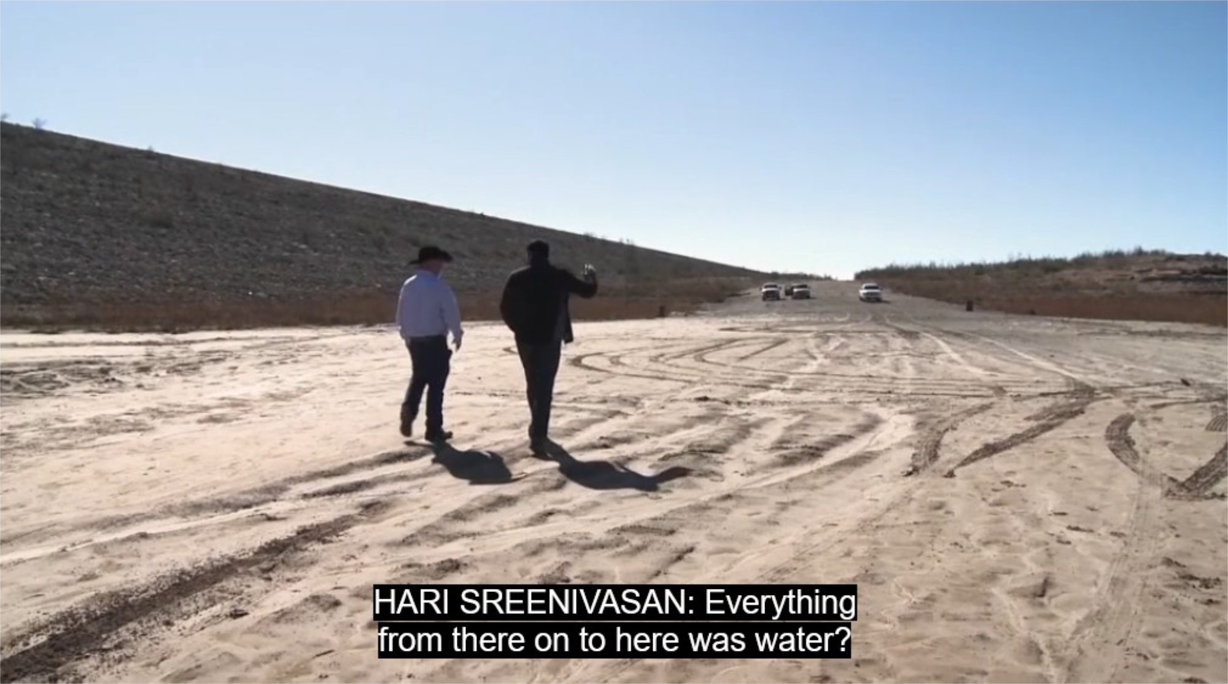
Screenshot from video "Drought Case Study: Texas" by PBS LearningMedia. See also two other videos about the impacts of drought by PBS Learning Media: "Drought Case Study: California" and "Drought Case Study: Cape Town."

Slide 28
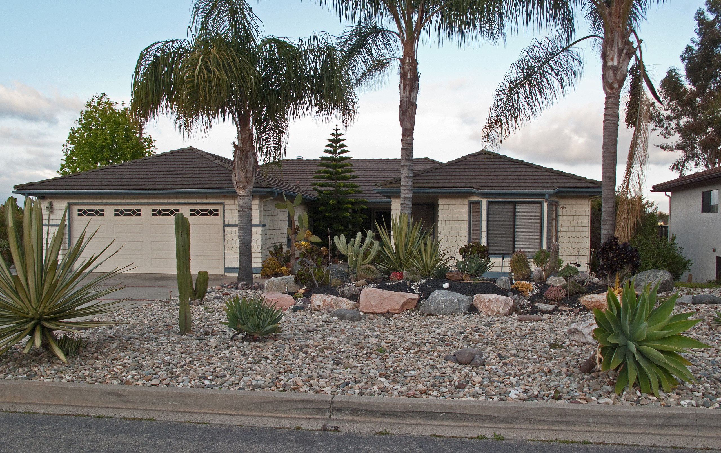
House in Southern California with xeriscaping, i.e. landscaping using plants that are tolerant of arid conditions. Photo by Downtowngal (CC BY-SA 3.0) via Wikimedia Commons

Slide 29
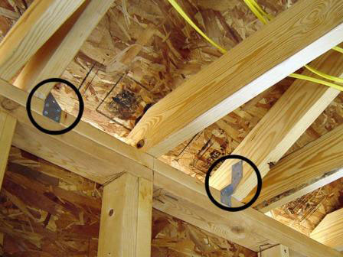
Hurricane clips, shown circled above, help anchor roofs to the main structure to prevent detachment due to severe wind. These clips can be found at many hardware stores, and are an inexpensive way to mitigate home damage from hurricanes. The home above kept its lid on during the severe winds brought by Hurricane Katrina, even though construction of the house had not been completed. Photo: Yonah Walter/FEMA (public domain) via Wikimedia Commons.

Slide 30
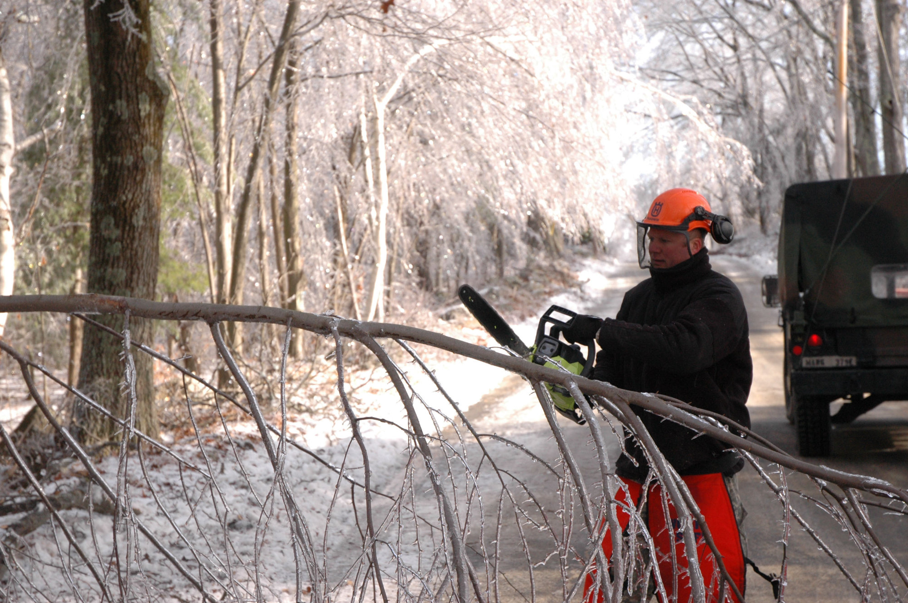
Spc. Daryl Johnson, a construction equipment operator, 379th Engineer Co. (Horizontal), Massachusetts Army National Guard, cuts a fallen tree with a chainsaw in Phillipston, Mass., Dec. 14, 2008. The town of Phillipston lost power when trees covered with ice began falling onto power lines leaving the towns 900 homes without electricity. The 379th was mobilized to cut down trees and clear roads so civilian utility companies can begin trying to restore power to the town. Photo: Sgt. 1st Class Jon Soucy (public domain) via Wikimedia Commons

Slide 31
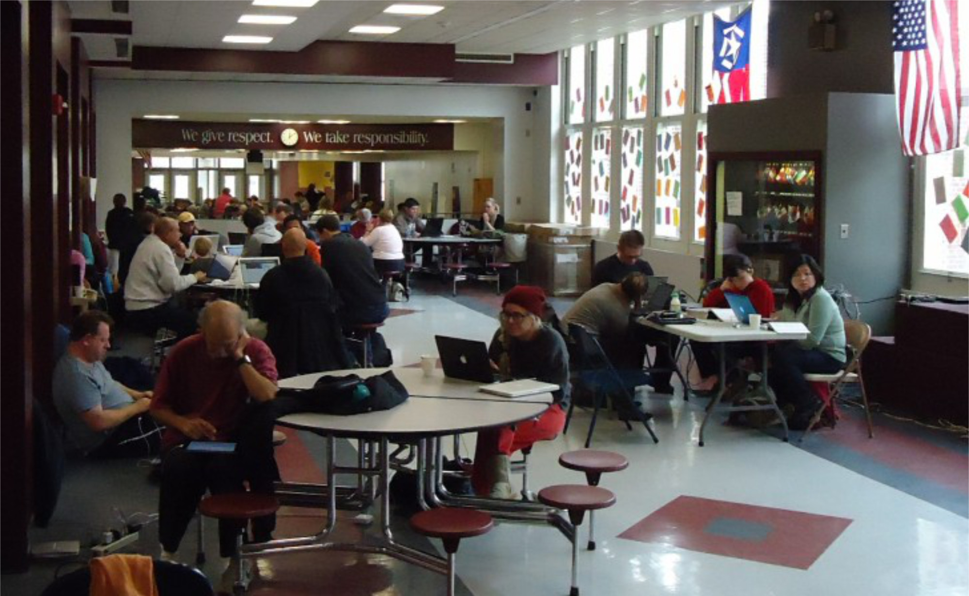
Red Cross warming and charging station at Summit Middle School in Summit, NJ, in the aftermath of Hurricane Sandy. Residents without power could come to the middle school to charge cell phones, have internet access, and keep warm. Image by Tomwsulcer (public domain via Wikimedia Commons)

Slide 32
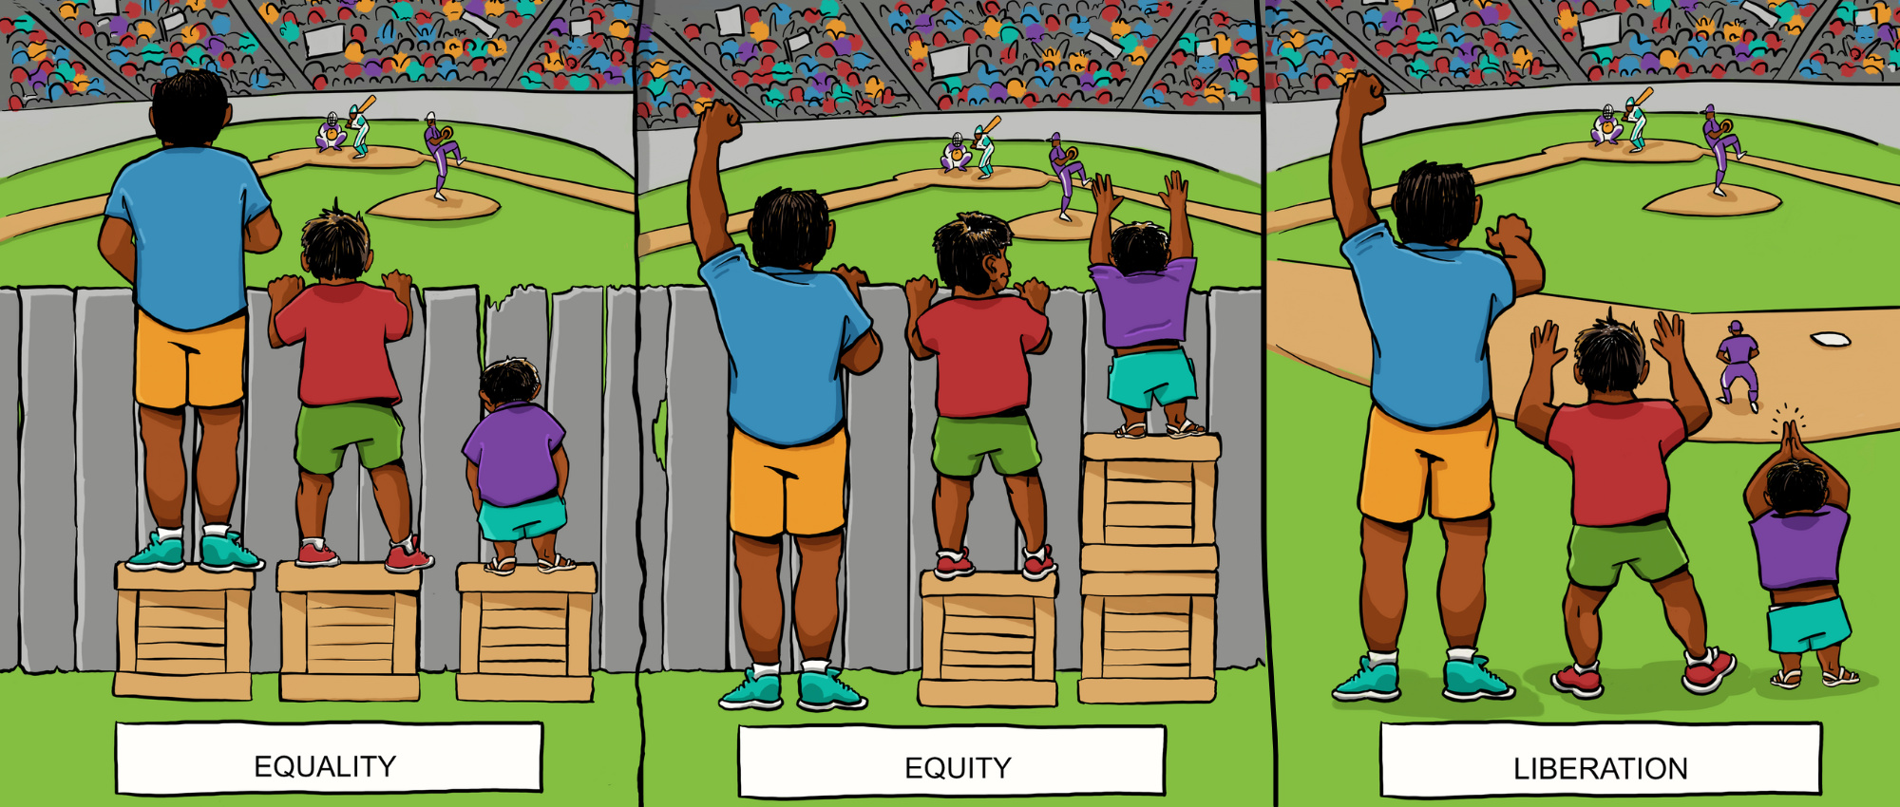
Illustration: A collaboration between Center for Story-based Strategy & Interaction Institute for Social Change. Artwork by Angus Maguire. CC BY-SA 4.0

Slide 33
Taqwa Community Farm Director Abu Talib in the half-acre park operated as a community garden in the Highbridge neighborhood of the Bronx, New York City. Photo: Preston Keres, USDA/FPAC (public domain) via Flickr

Slide 34
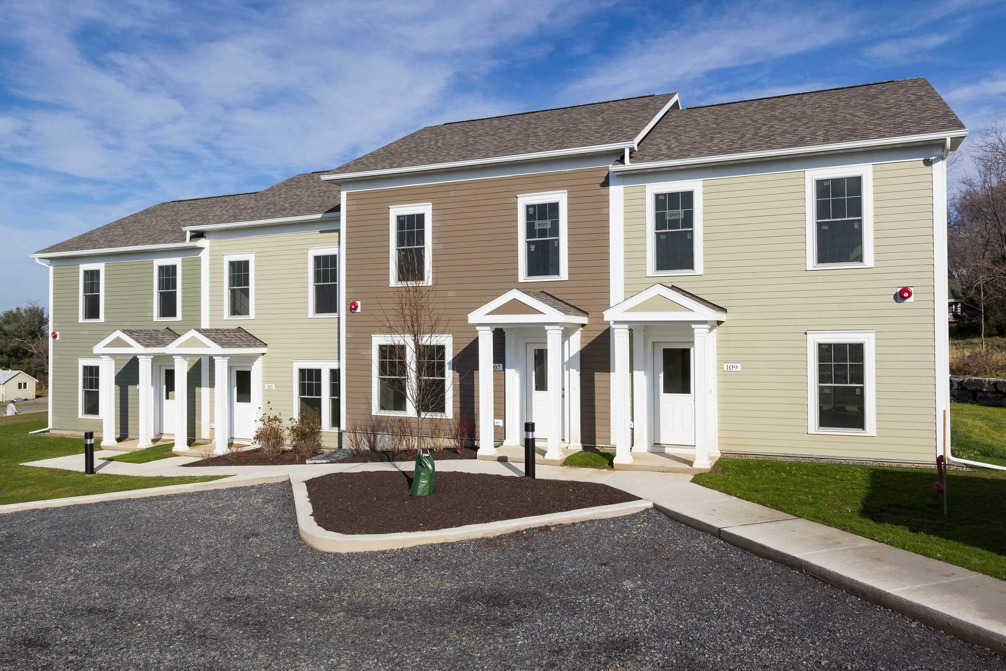
Photos of energy-efficient, affordable housing developed in Ithaca, NY by Ithaca Neighborhood Housing Services (INHS), a nonprofit organization that serves seven counties throughout the Finger Lakes and Southern Tier in New York State. INHS's description of this particular project, Holly Creek, states: "Completed in two phases, Holly Creek earned the ENERGY STAR LEED Gold Certification and was awarded the Housing Innovation Award by the U.S. Department of Energy. The homes sold at starting prices of $104,000, well below the county’s median price of $183,000." Photos: INHS, used with permission.

Slide 35
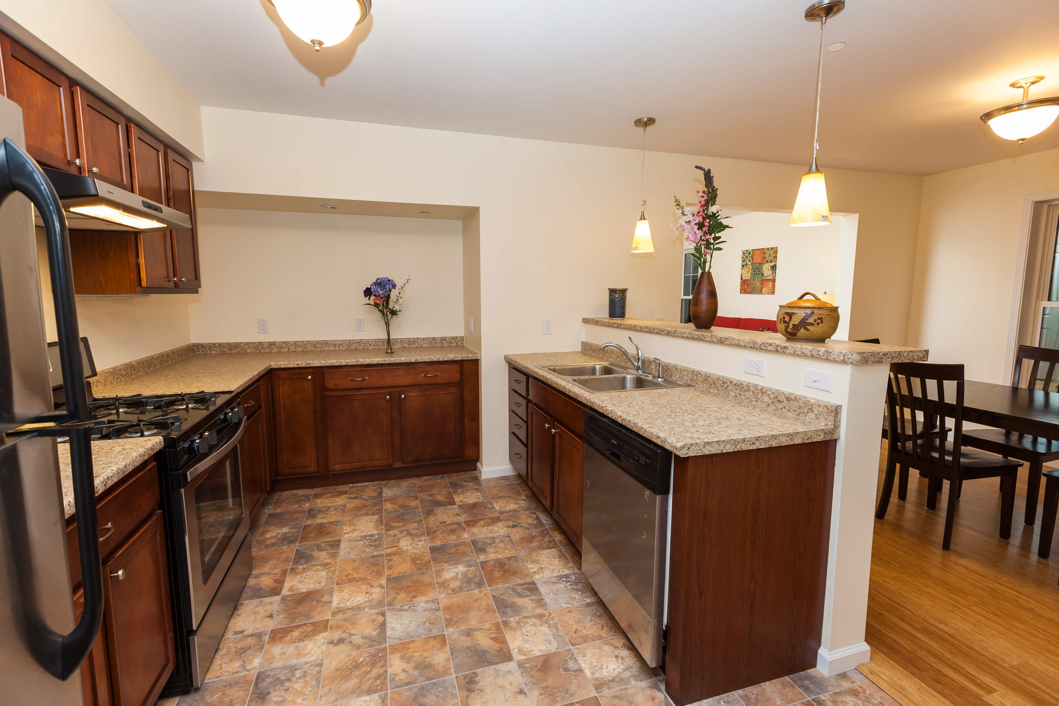
Photos of energy-efficient, affordable housing developed in Ithaca, NY by Ithaca Neighborhood Housing Services (INHS), a nonprofit organization that serves seven counties throughout the Finger Lakes and Southern Tier in New York State. INHS's description of this particular project, Holly Creek, states: "Completed in two phases, Holly Creek earned the ENERGY STAR LEED Gold Certification and was awarded the Housing Innovation Award by the U.S. Department of Energy. The homes sold at starting prices of $104,000, well below the county’s median price of $183,000." Photos: INHS, used with permission.

Slide 36
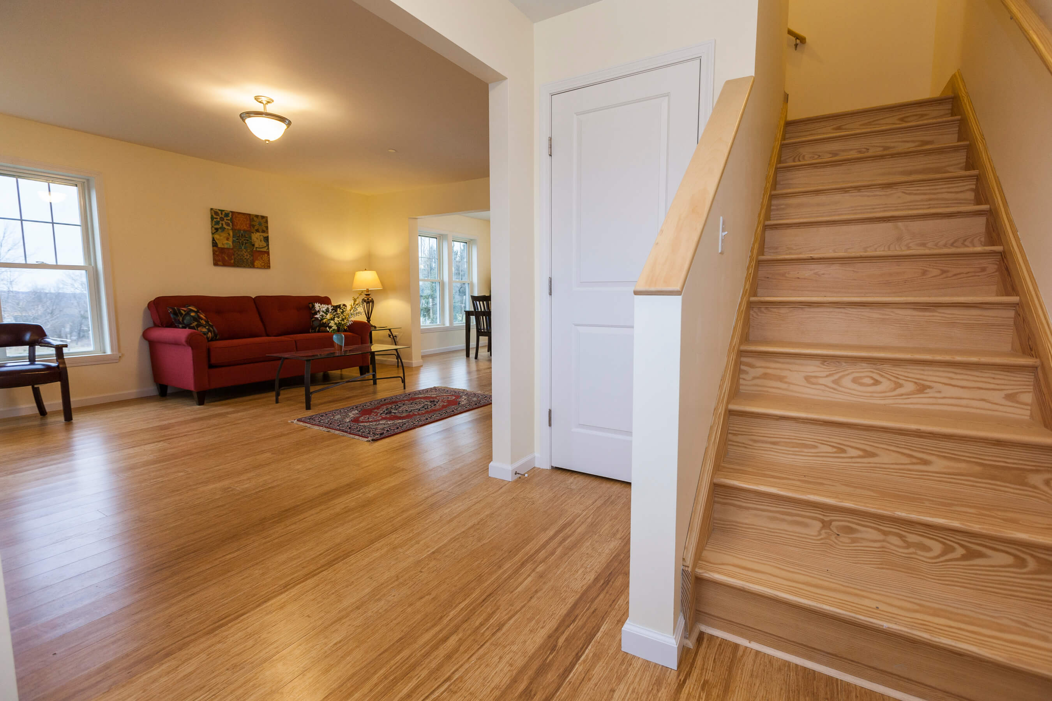
Photos of energy-efficient, affordable housing developed in Ithaca, NY by Ithaca Neighborhood Housing Services (INHS), a nonprofit organization that serves seven counties throughout the Finger Lakes and Southern Tier in New York State. INHS's description of this particular project, Holly Creek, states: "Completed in two phases, Holly Creek earned the ENERGY STAR LEED Gold Certification and was awarded the Housing Innovation Award by the U.S. Department of Energy. The homes sold at starting prices of $104,000, well below the county’s median price of $183,000." Photos: INHS, used with permission.

Slide 37
StockSnap via Pixabay

Slide 38
Image: Canva.com

Slide 39
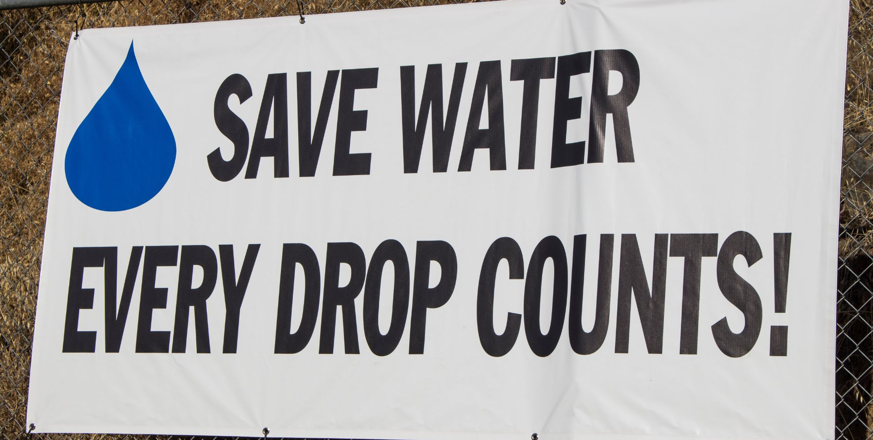
Image: Canva.com

Slide 40
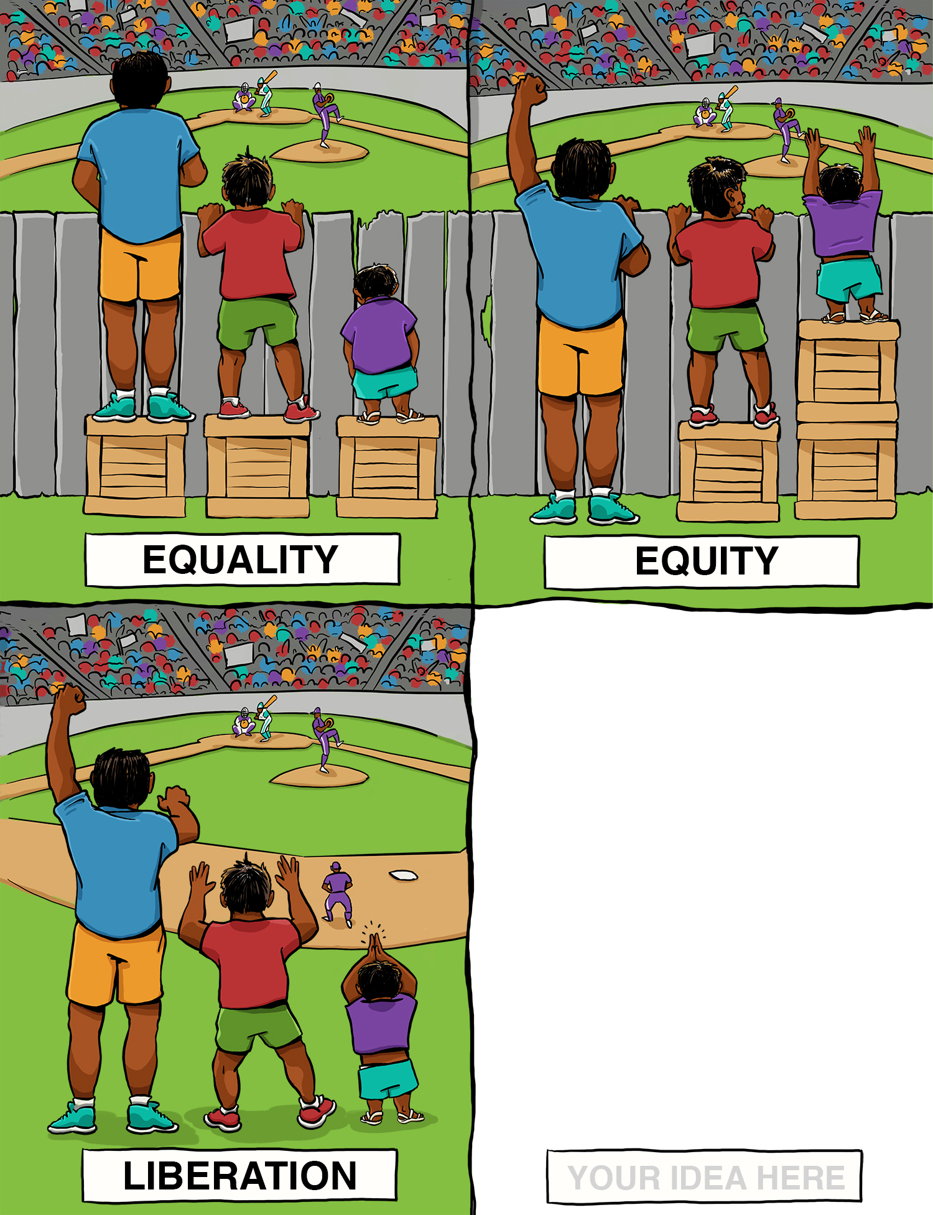
Image: A collaboration between Center for Story-based Strategy & Interaction Institute for Social Change. Artwork by Angus Maguire. CC BY-SA 4.0

Slide 41
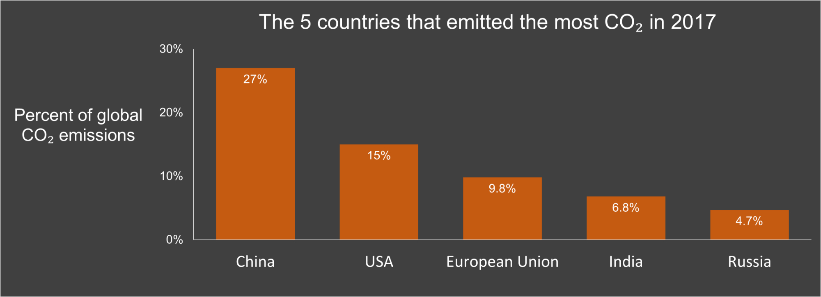
Figure created by Ingrid Zabel for PRI's Earth@Home project (CC BY-NC-SA 4.0 license), with data from OurWorldInData.org

Slide 42
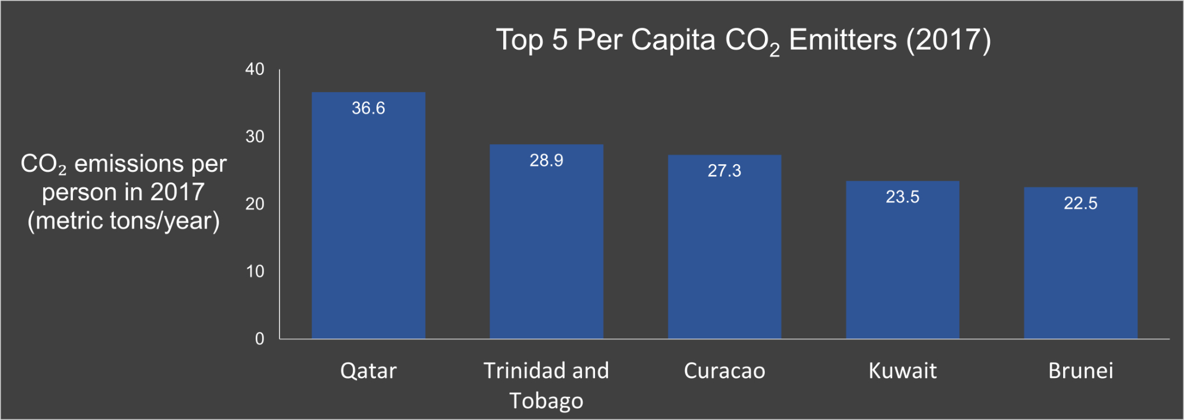
Figure created by Ingrid Zabel for PRI's Earth@Home project (CC BY-NC-SA 4.0 license), with data from OurWorldInData.org

Slide 43
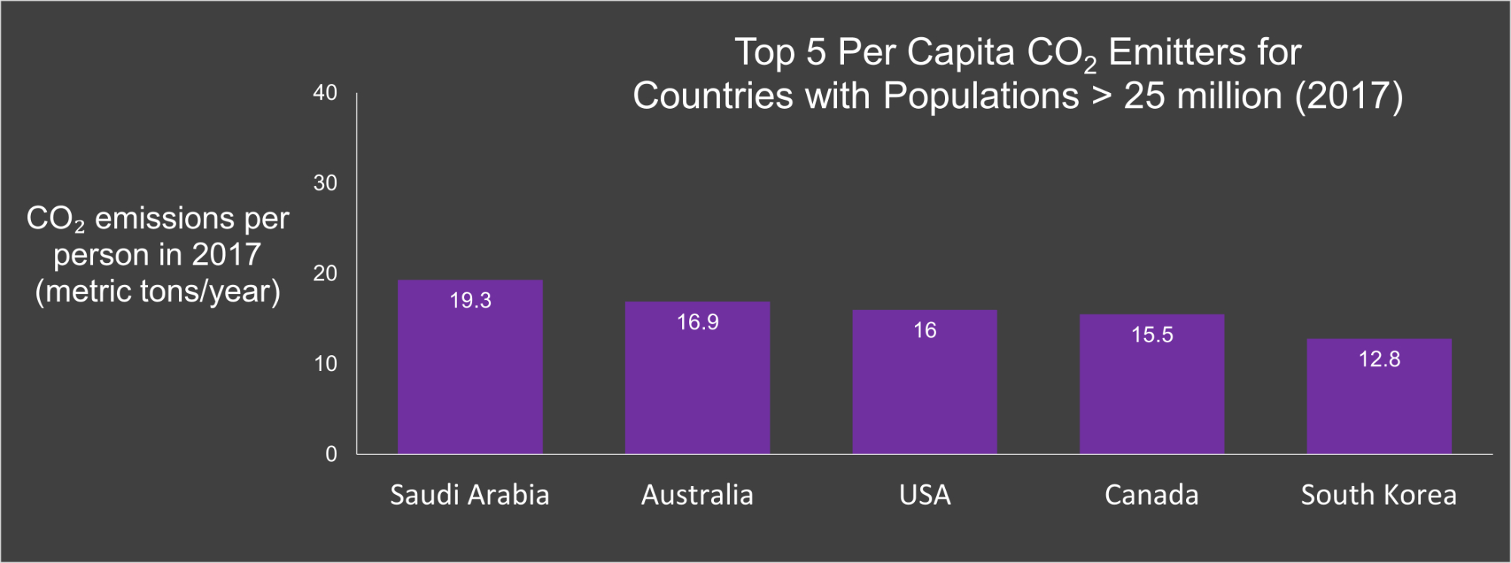
Figure created by Ingrid Zabel for PRI's Earth@Home project (CC BY-NC-SA 4.0 license), with data from OurWorldInData.org

Slide 44
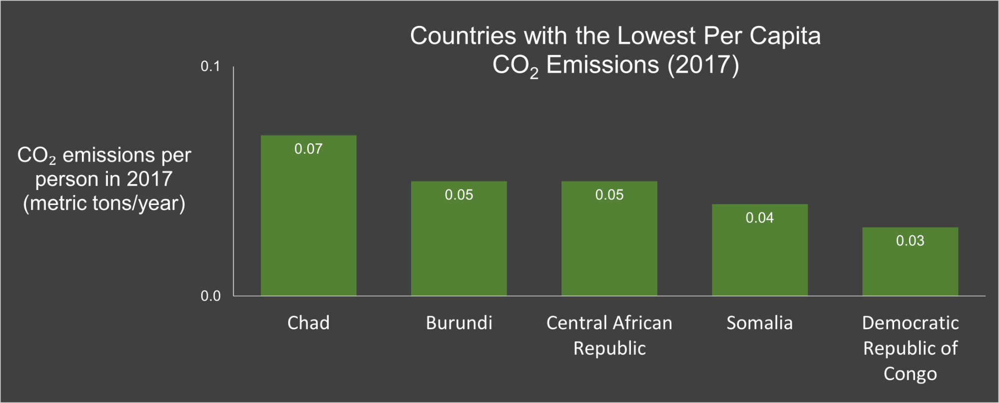
Figure created by Ingrid Zabel for PRI's Earth@Home project (CC BY-NC-SA 4.0 license), with data from OurWorldInData.org

Slide 45
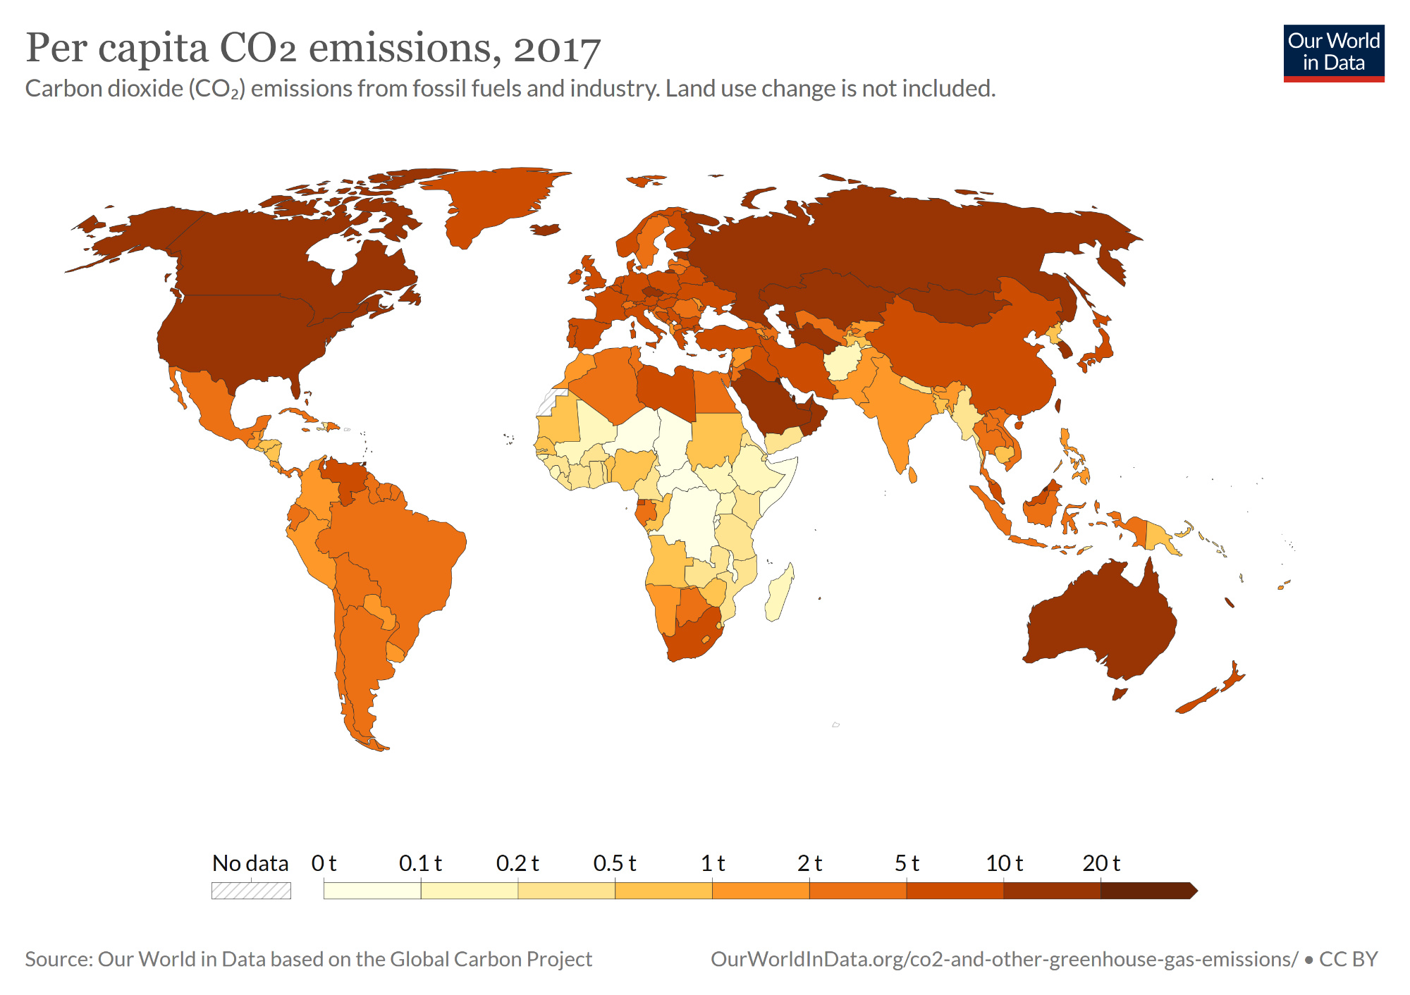
Map: OurWorldinData.org based on the Global Carbon Project (CC BY 4.0)

Slide 46
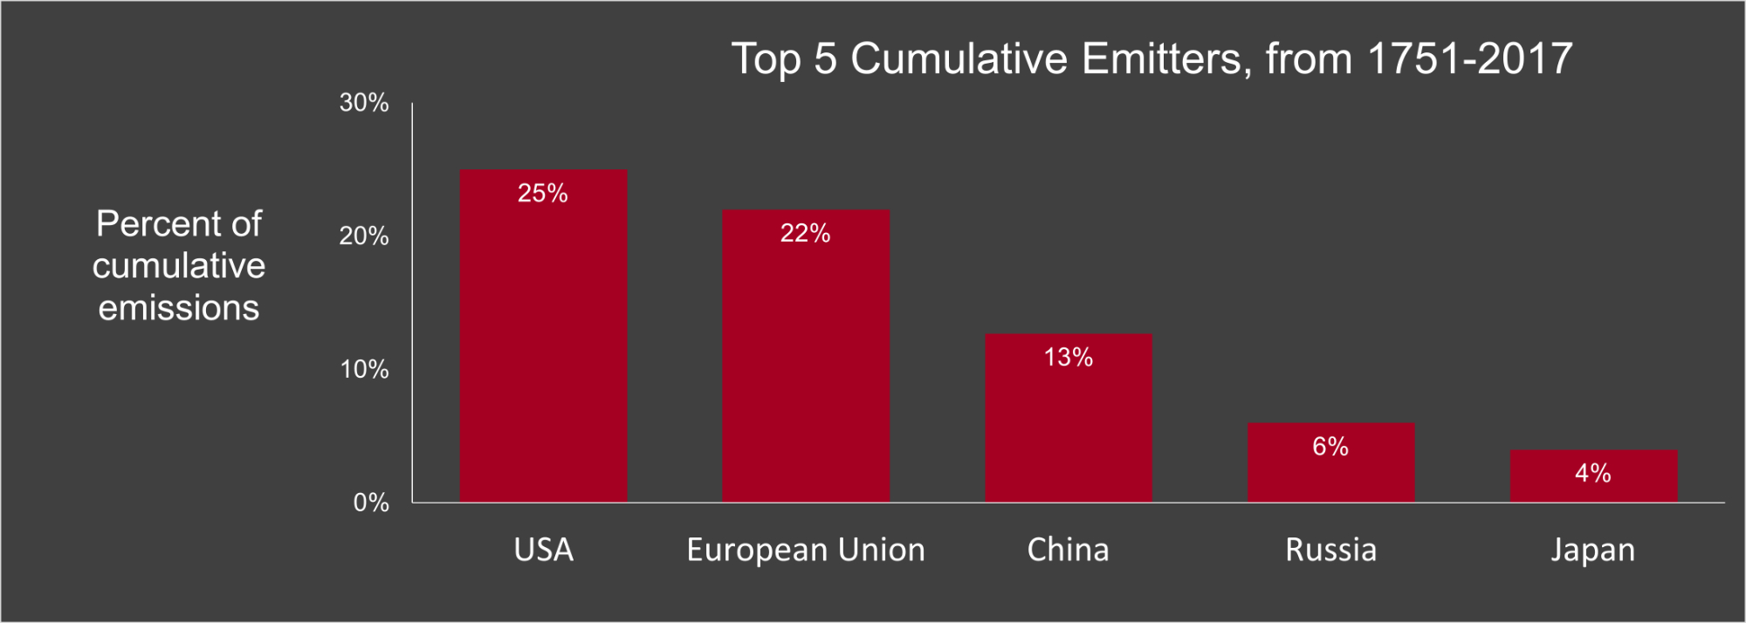
Figure created by Ingrid Zabel for PRI's Earth@Home project (CC BY-NC-SA 4.0 license), with data from OurWorldInData.org

