Slide 1
Photo from Haas family collection, used with permission

Slide 2
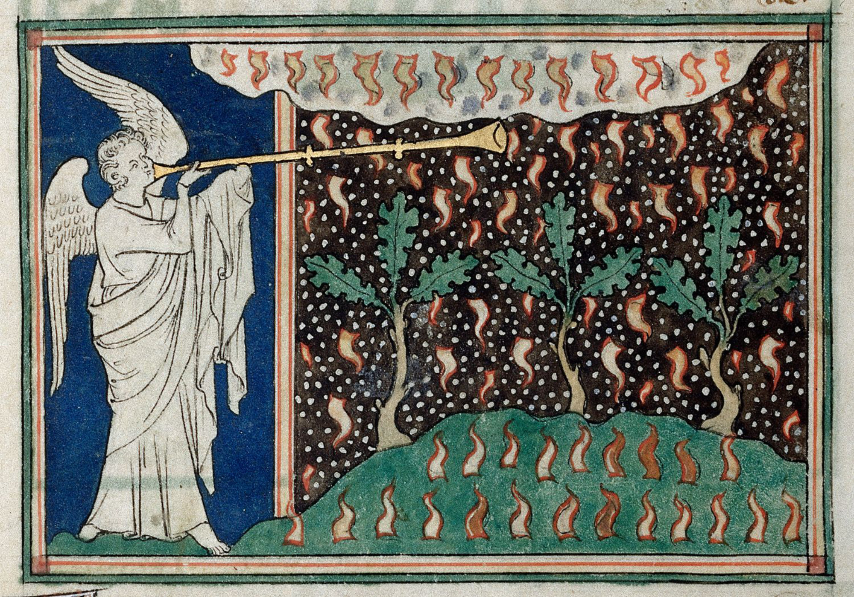
Queen Mary Apocalypse, 14th century, unknown artist, public domain license via Wikimedia Commons

Slide 3
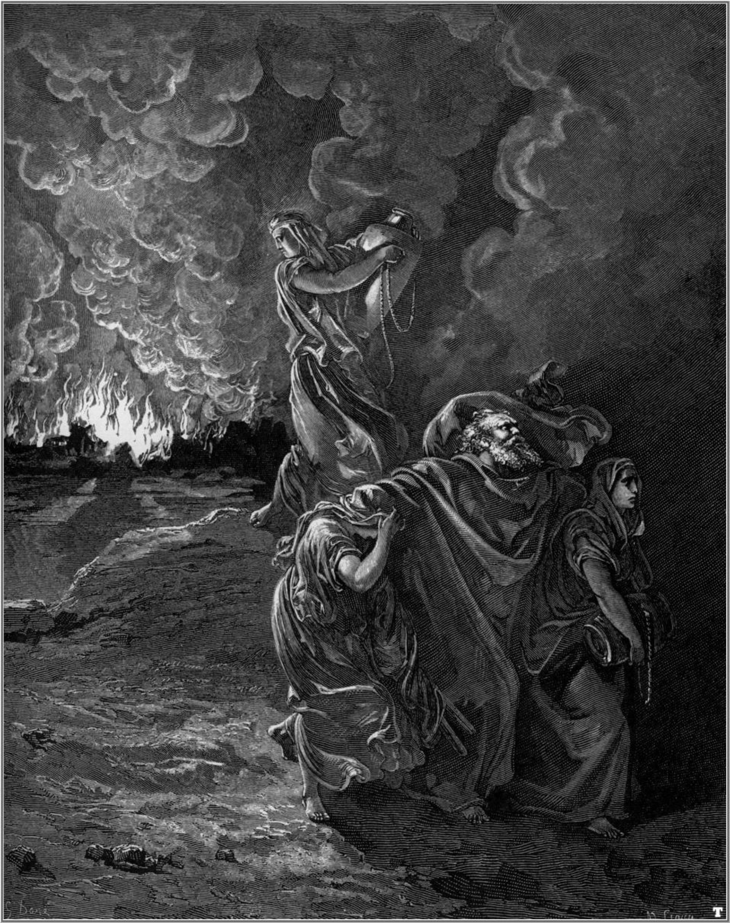
Flight of Lot by Gustave Doré (1832–1883), public domain license via Wikimedia Commons

Slide 4
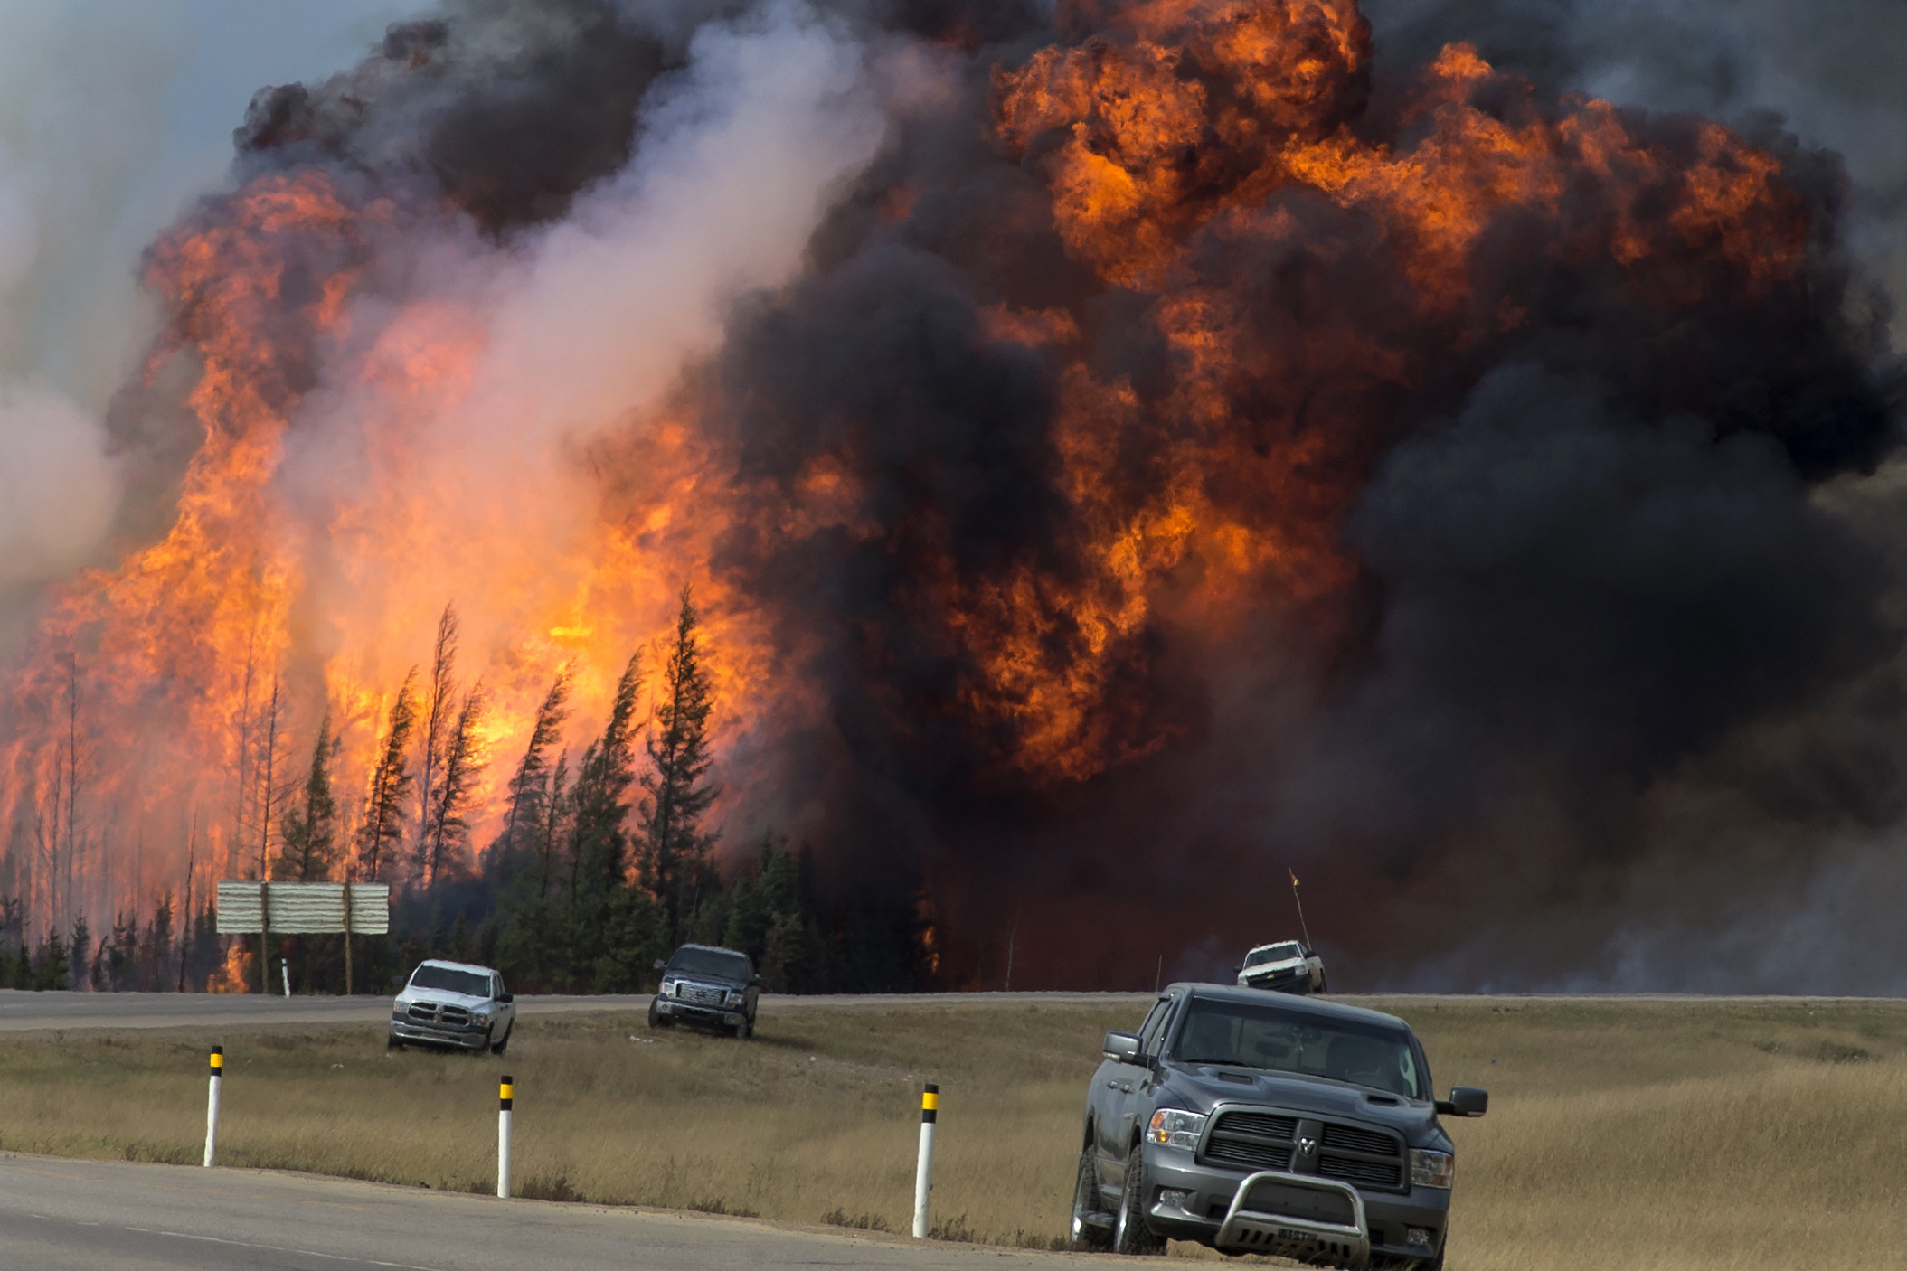
Fire near the Fort McMurray oil sands production facility in Alberta, Canada. Photo: PremierofAlberta (CC BY-ND 2.0) via Flickr

Slide 5
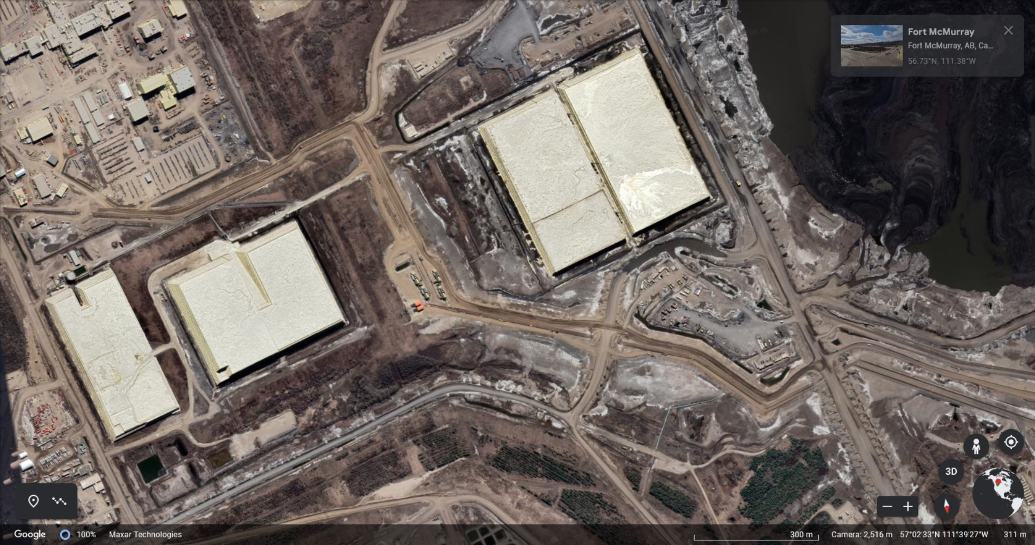
Oil sands production facility near Fort McMurray, Alberta. The light-colored, rectangular structures are huge sulfur "pyramids". Image: Google Earth.

Slide 6
Photo from Canva

Slide 7
Photo from Canva

Slide 8
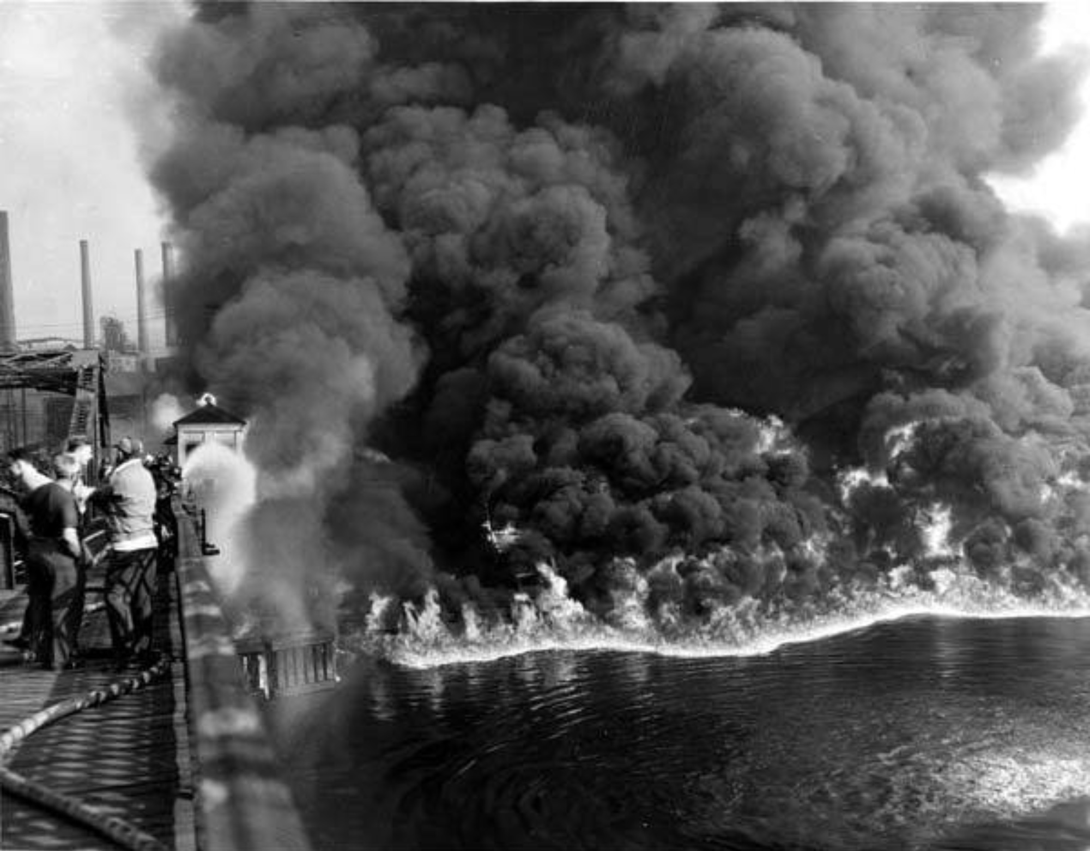
Cleveland's Cuyahoga River caught fire multiple times since the first known blaze in 1868. The fire pictured occurred in 1952. Photo by Thomas James. Source: CLEVELANDmemory.org; from Michael Schwartz Library, Special Collections/Cleveland State University.

Slide 9
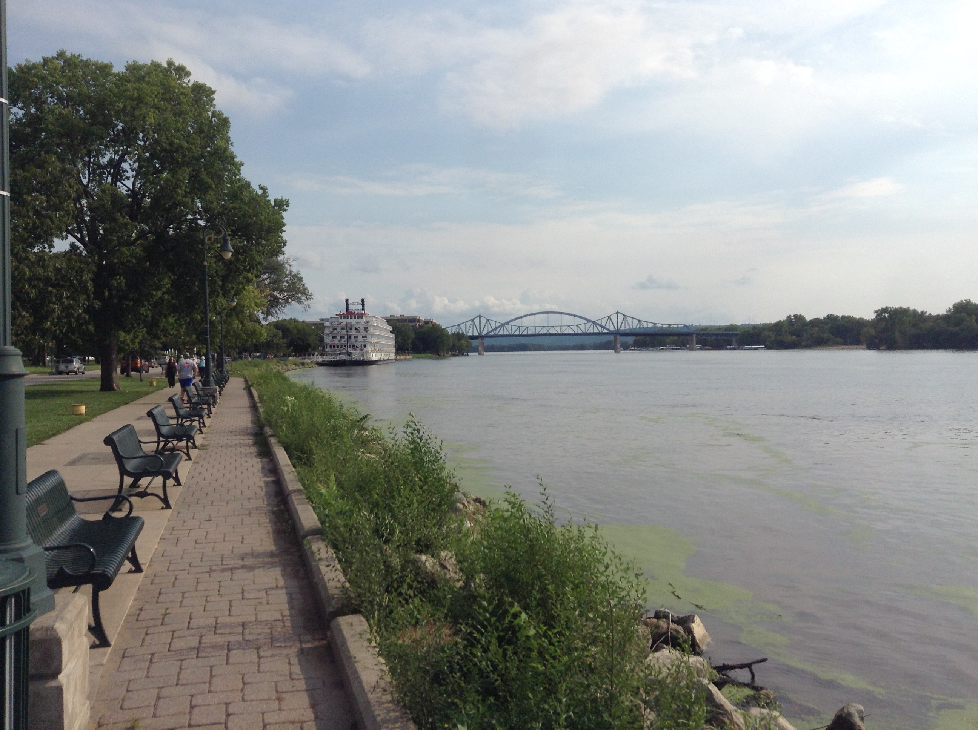
Cleveland's Cuyahoga River in 2016. Photo by Wikideas1 (CC0 1.0 license), via Wikimedia Commons

Slide 10
People celebrating the 2019 entry into force of the Kigali Amendment to the Montreal Protocol. The Montreal Protocol was the original international agreement that phased out production and use of ozone-depleting gases such as chlorofluorocarbons (CFCs). However, it turned out that hydrofluorocarbons (HFCs) that were developed to replace CFCs are very powerful, long-lived greenhouse gases, and the 2019 amendment is an agreement to replace HFCs with environmentally-friendly alternatives. Photo: Ministry of Environment - Rwanda (CC BY-ND 2.0) via Flickr.

Slide 11
Photo from Canva

Slide 12
President Reagan and General Secretary Gorbachev signing the INF Treaty in the East Room of the White House on December 8, 1987. Photo by White House Photographic Office (public domain) via Wikimedia Commons.

Slide 13
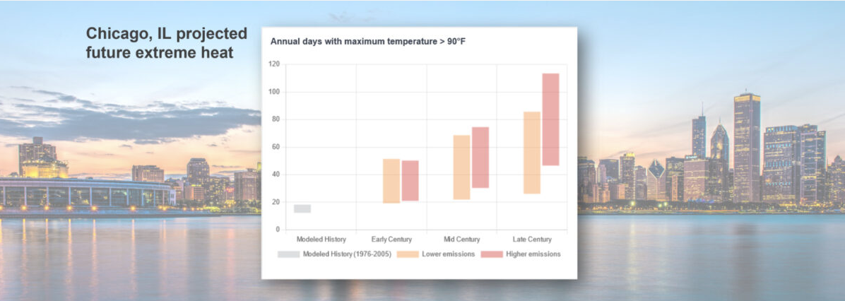
Projections of the number of days per year in Chicago, IL in which the temperature reaches above 90°F. In the lower emissions scenario (RCP4.5), global carbon emissions reach a maximum in the year 2040 and then start to decline; in the higher emissions scenario (RCP8.5), global carbon emissions increase throughout the 21st century. Figure by Ingrid Zabel for PRI's Earth@Home project (CC BY-NC-SA 4.0 license), with chart from the National Oceanic and Atmospheric Administration's Climate Mapping for Resilience and Adaptation tool.

Slide 14
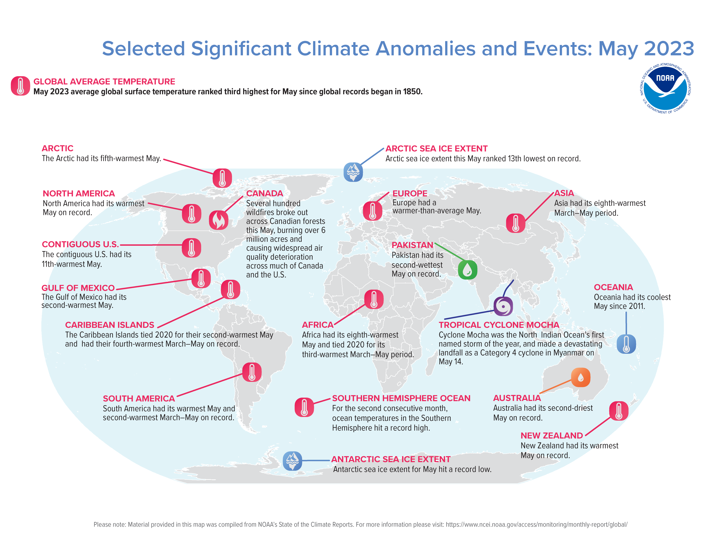
The summary map from NOAA's Global Climate Report for May 2023 is pretty depressing. See this and other monthly climate reports on NOAA's National Centers for Environmental Information Monthly Reports page.

Slide 15
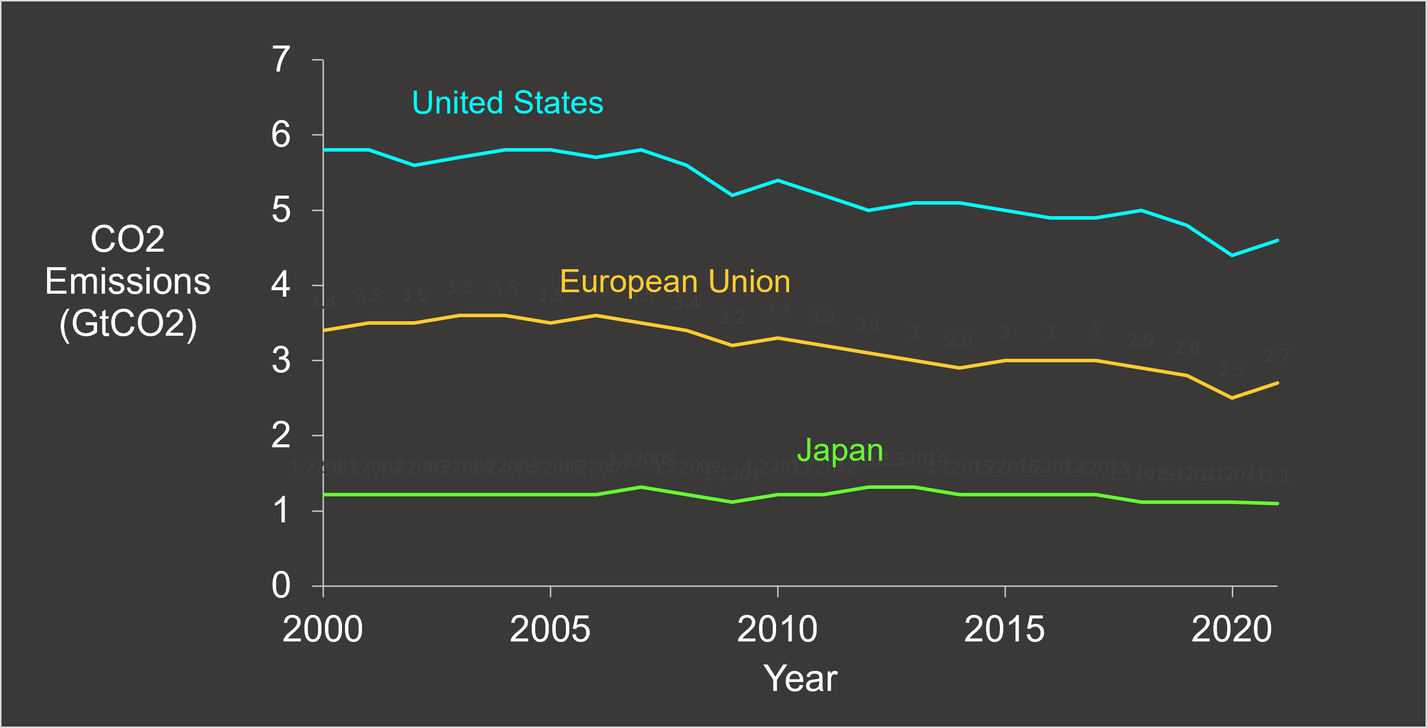
CO2 emissions in selected advanced economies, 2000-2021. Figure by Ingrid Zabel for PRI's Earth@Home project with data from International Energy Agency (IEA) (CC BY-NC-SA 4.0 license).

Slide 16
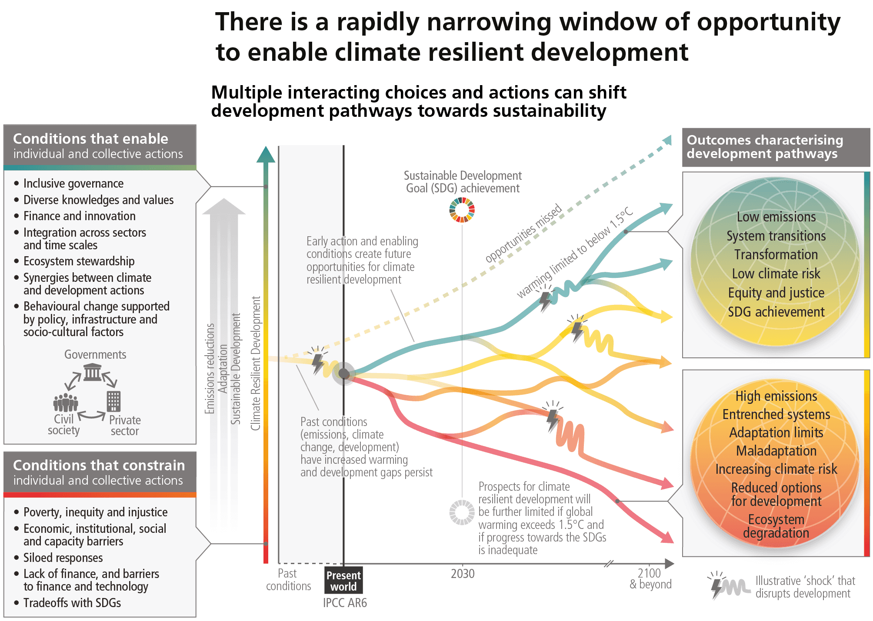
Our climate future is uncertain. One of the greatest contributors to that uncertainty is the difficulty in predicting human behaviors across multiple scales. How will government and industry act? Will individuals engage in collective actions? This is Figure SPM.6 from the IPCC's Synthesis Report of the Sixth Assessment Report.

Slide 17
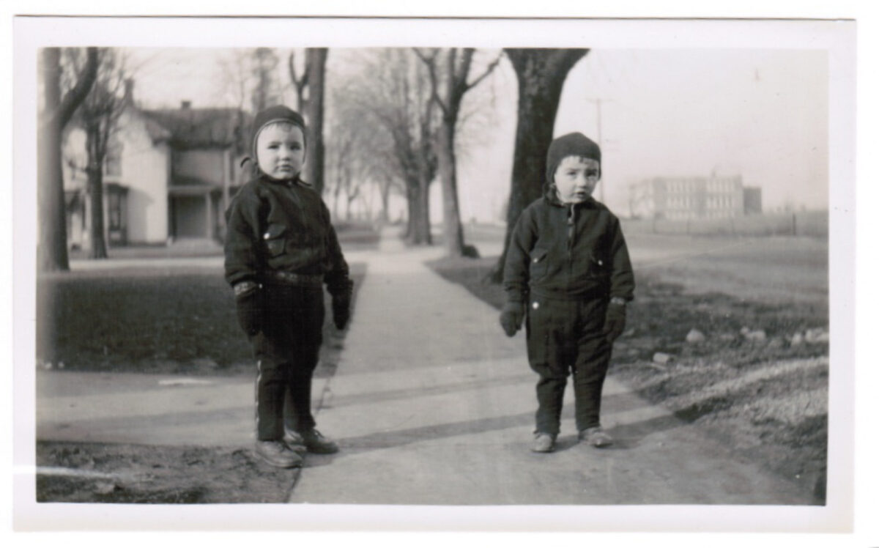
Photo from Haas family collection, used with permission

Slide 18
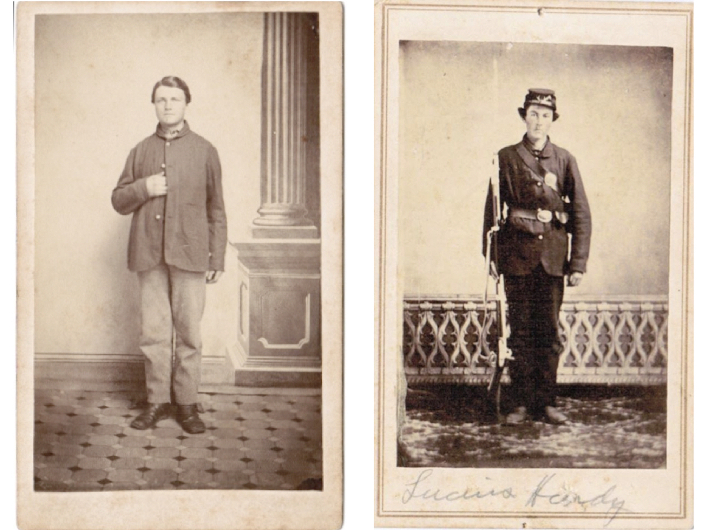
Photo from Haas family collection, used with permission

Slide 19
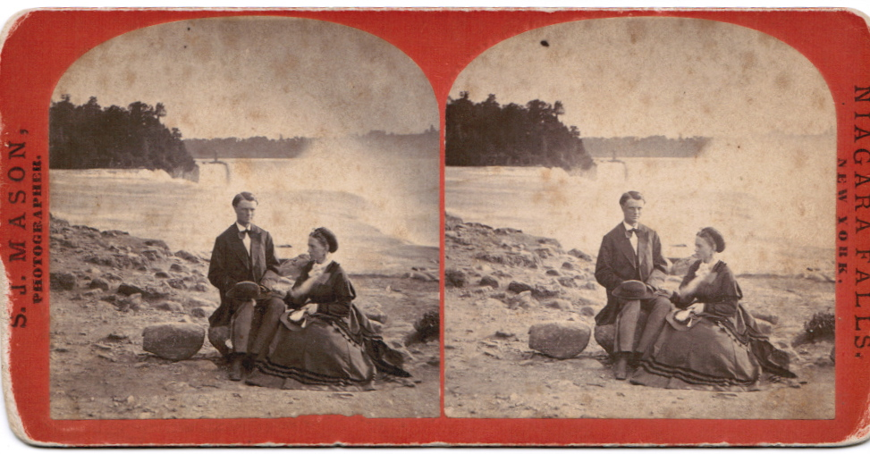
Photo from Haas family collection, used with permission

Slide 20
Photo from Haas family collection, used with permission

Slide 21
Hitler Walking Near Soldiers. Unidentified photographer (probably the photo studio/company of Heinrich Hoffmann, published/released through news and photo agencies). GattoFurryPazzo (CC BY-SA 4.0 license) via Wikimedia Commons

Slide 22
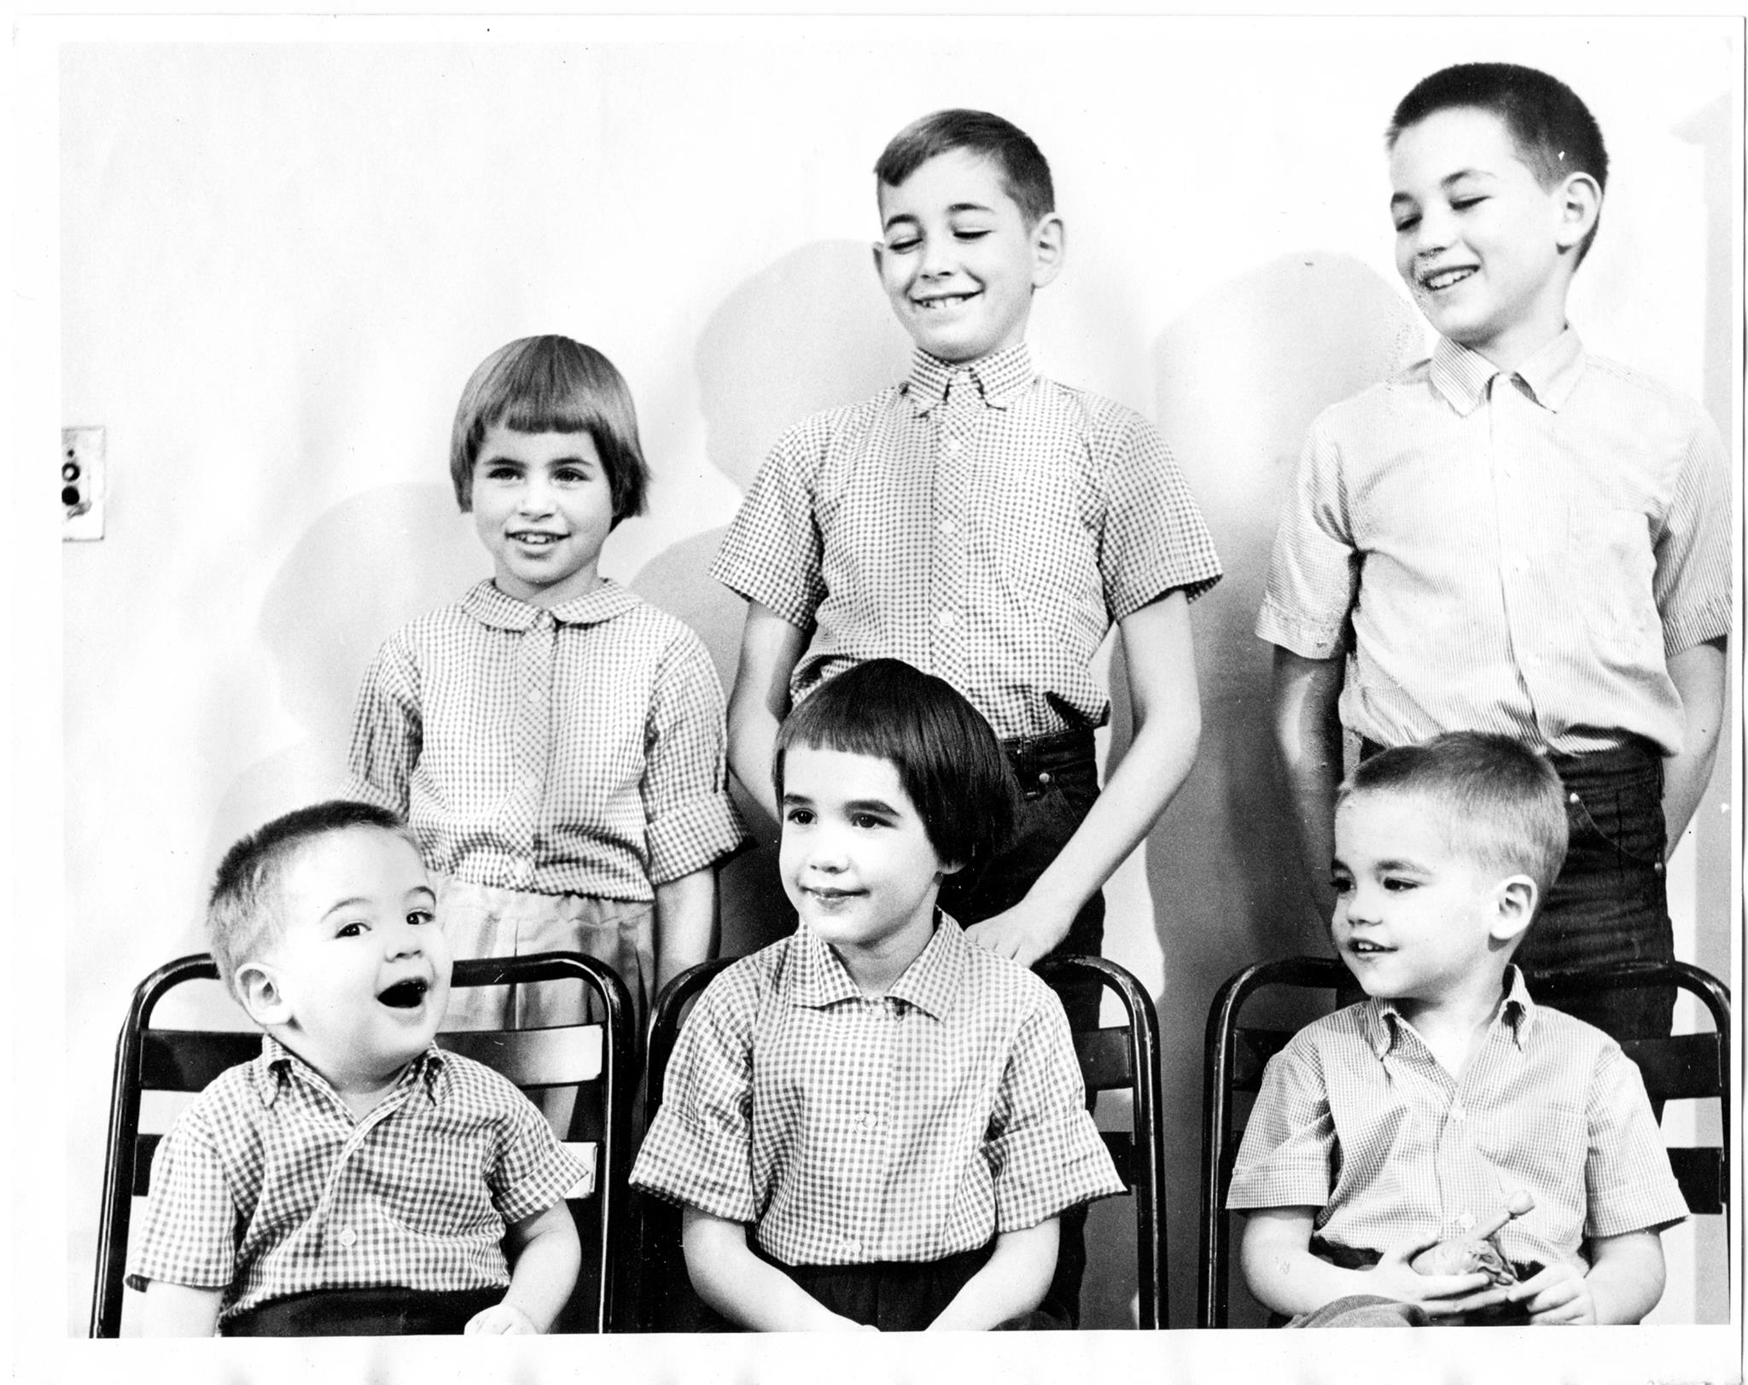
Photo from Haas family collection, used with permission

Slide 23
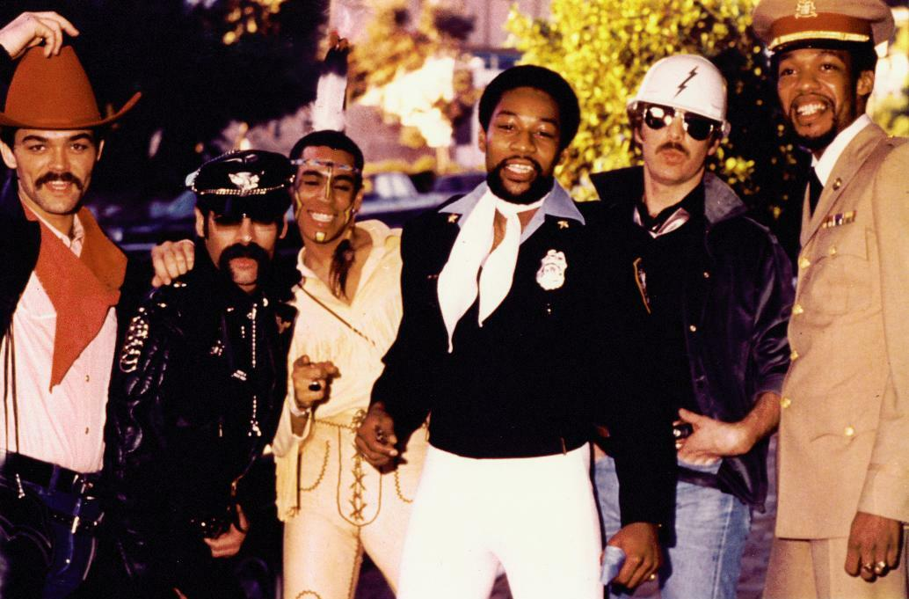
Original members of the disco group Village People 1978. Mario Casciano, (CC BY-SA 3.0 license) via Wikimedia Commons

Slide 24
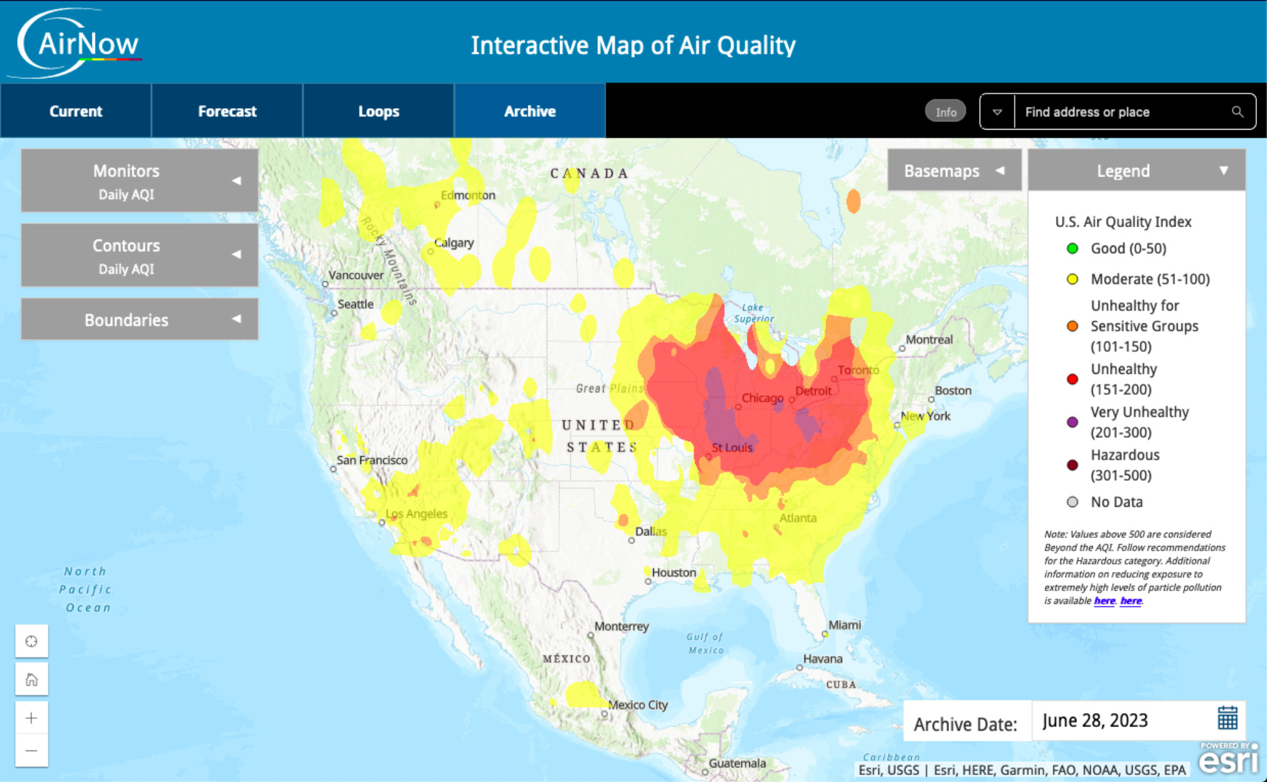
Canadian wildfires caused poor air quality throughout much of the United States in June of 2023. This image shows June 28, 2023. See the current Air Quality Index at airnow.gov. Source: AirNow Archive.

Slide 25
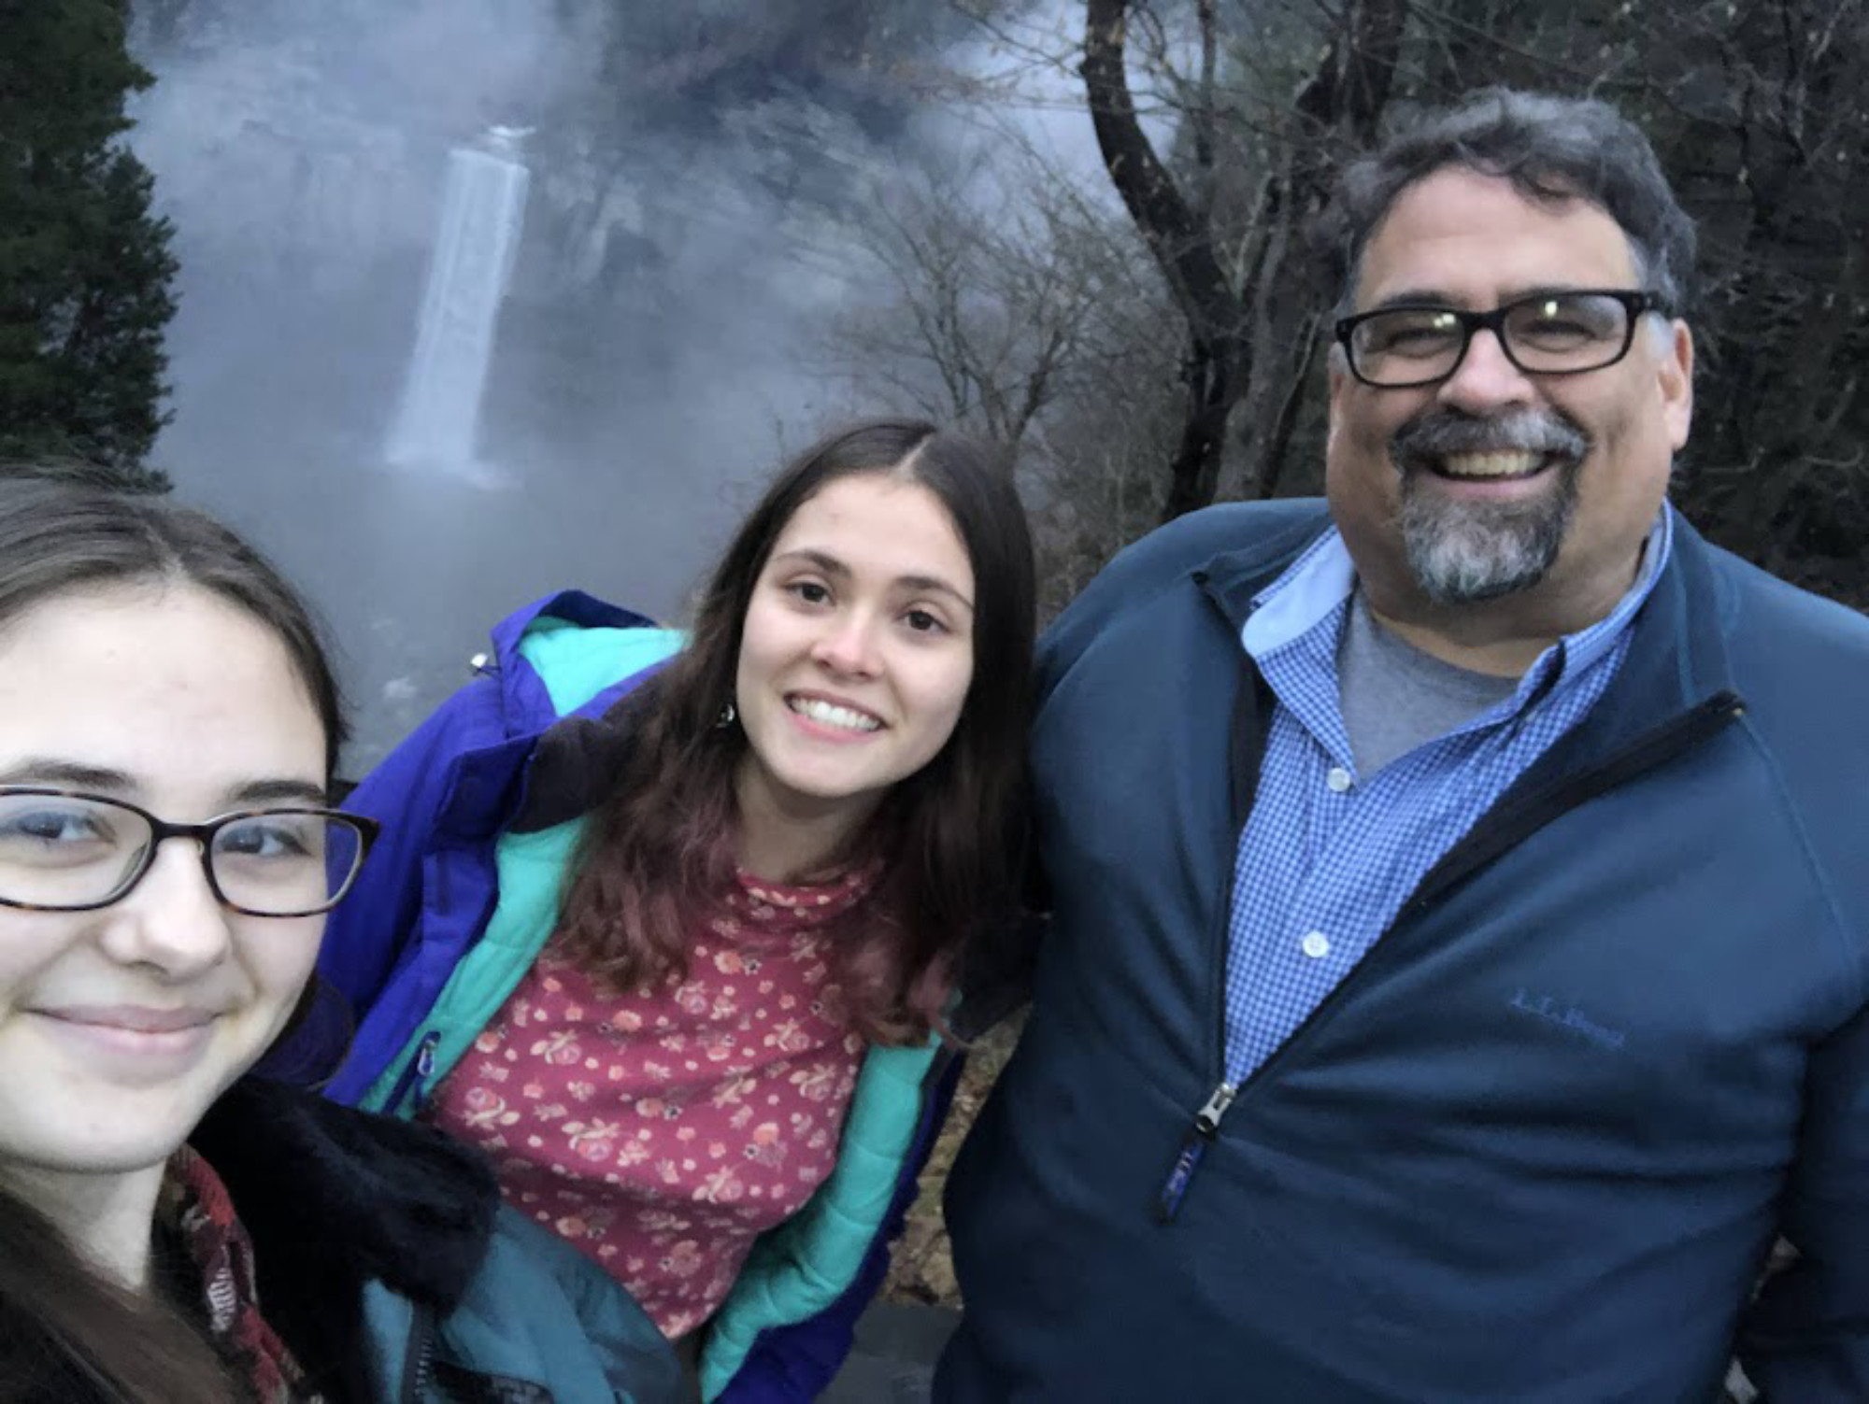
Photo by Nellie Duggan-Haas

Slide 26
Photo from Canva

Slide 27
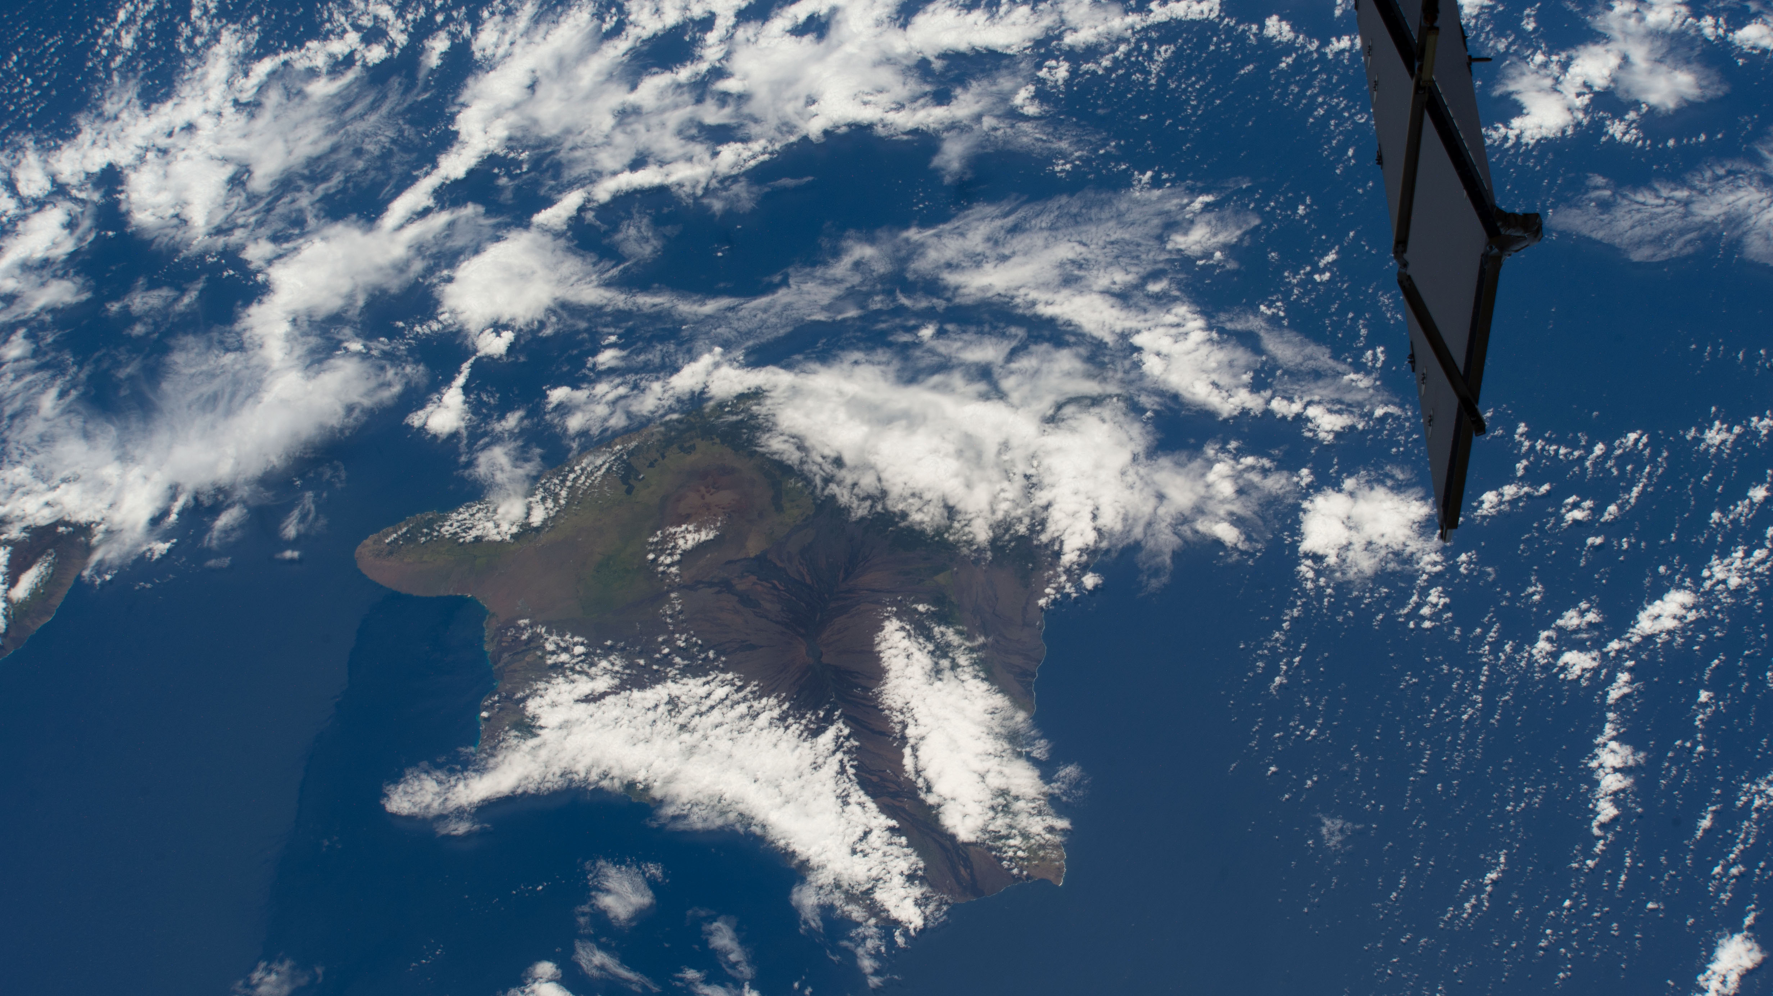
The world is beautiful. Clouds cover the Island of Hawaii, the youngest and largest of eight islands in the chain, as the International Space Station orbited 258 miles above the Pacific Ocean on June 24, 2023. Photo credit: NASA.

Slide 28
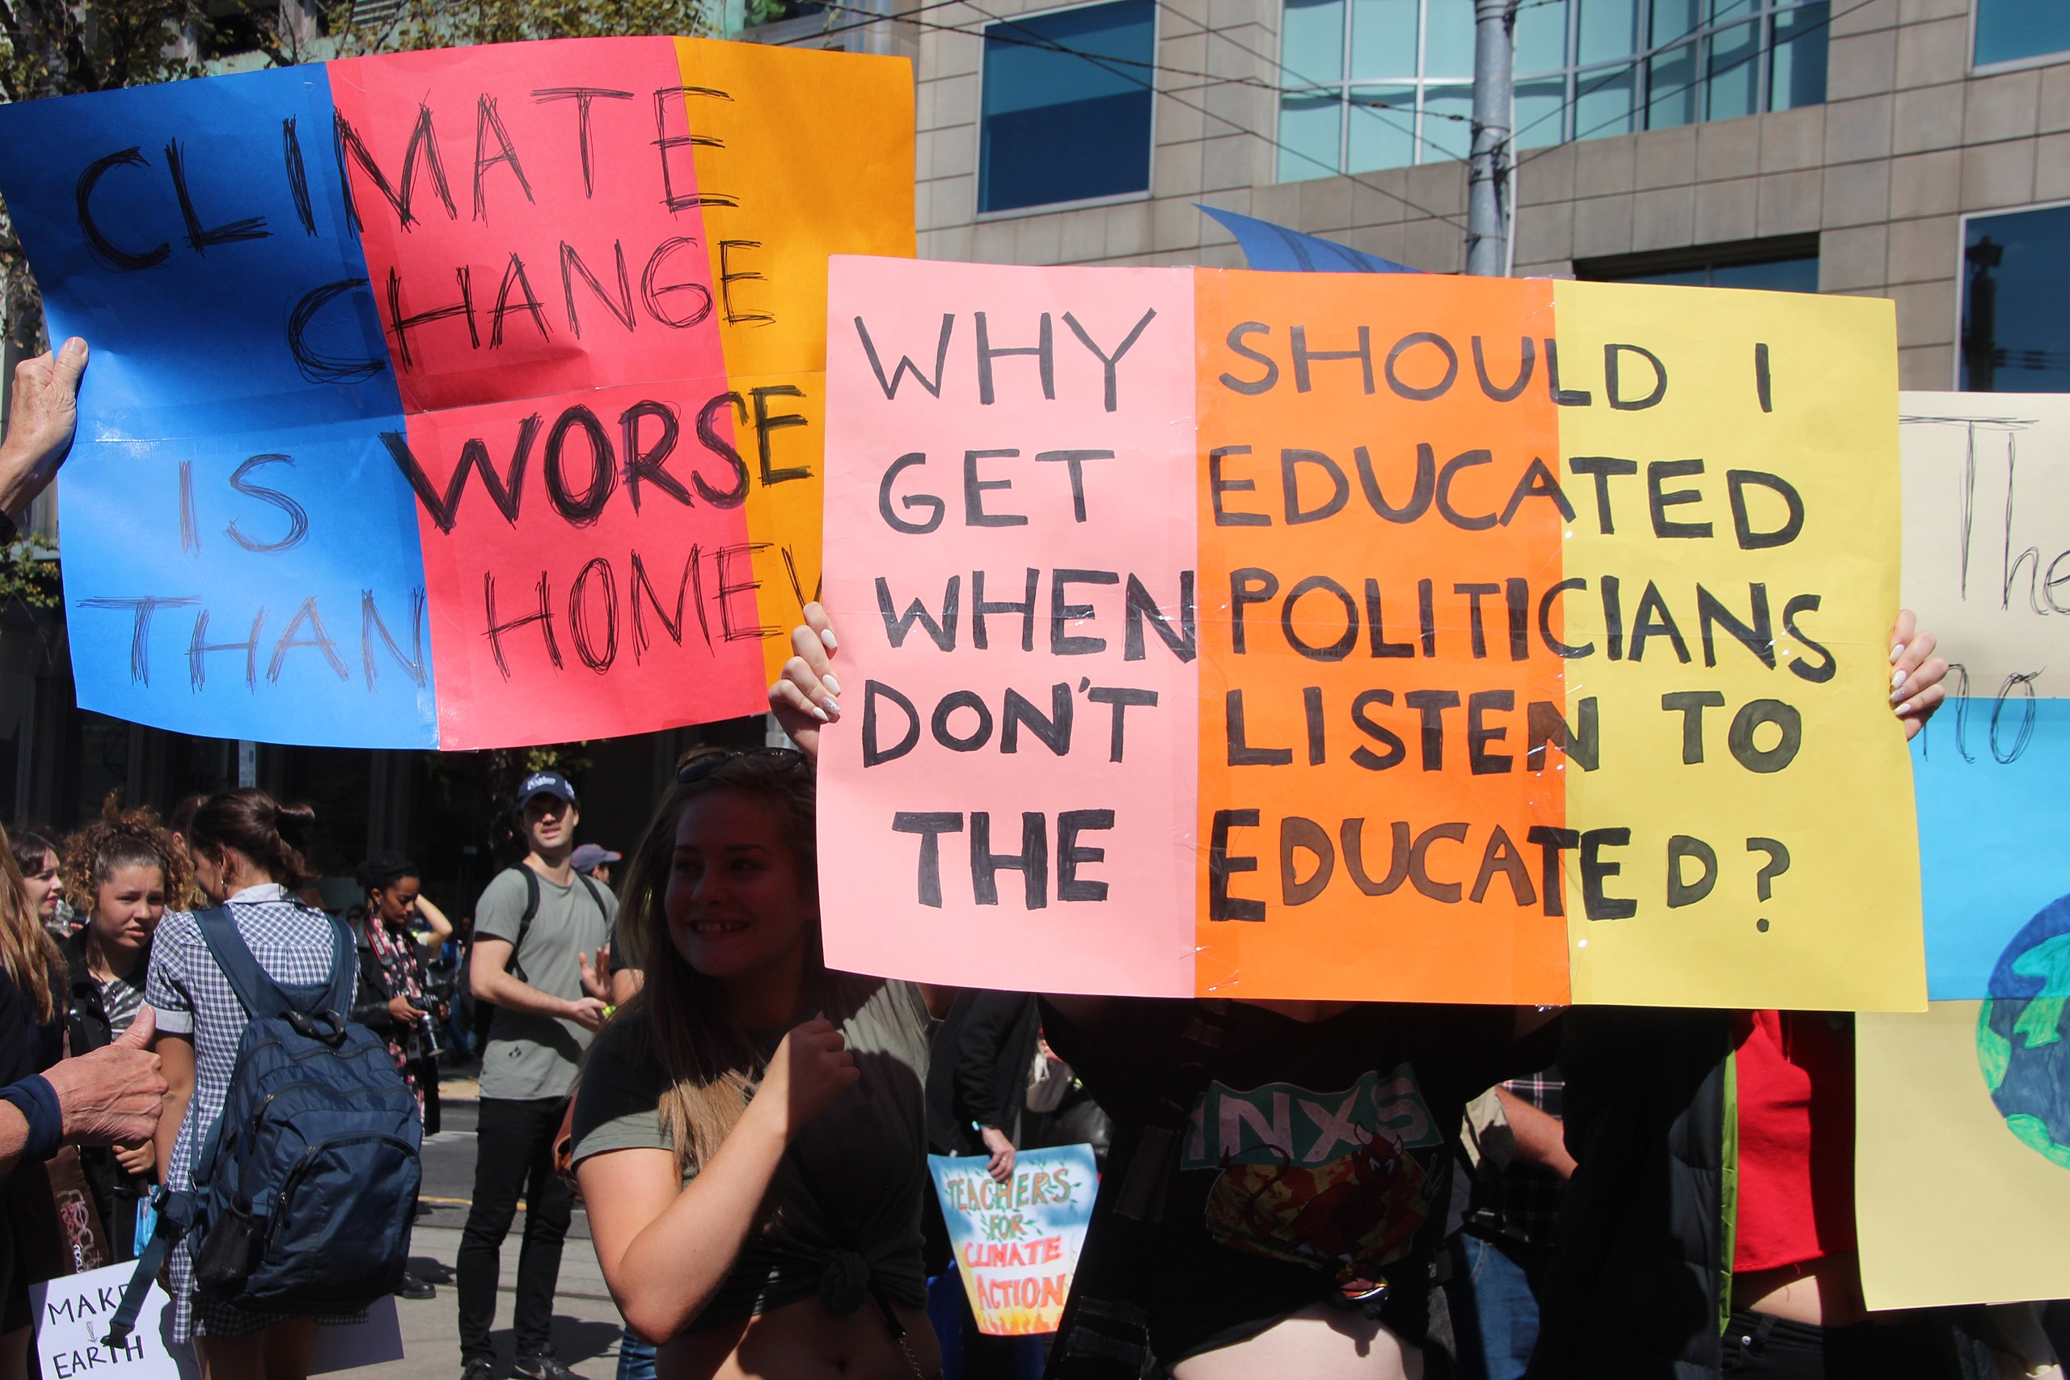
Melbourne, Australia was part of the global climate strike on March 15, 2019 drawing an enormous crowd estimated at 40,000 people, the vast majority school students. Photo: Takver (CC BY-SA 2.0 license) via Wikimedia Commons.

Slide 29
Photo from Canva

